Slide 1
Chapter 1
Introduction

Slide 2
Topics
Reasons for Studying Concepts of Programming Languages
Programming Domains
Language Evaluation Criteria
Influences on Language Design
Language Categories
Language Design Trade-Offs
Implementation Methods
Programming Environments

Slide 3
Why do we need to study the concepts of PLs?
Increased ability to express ideas
∴hence reducing the limitations posed by a particular programming language.
Improved background for choosing appropriate languages
Avoid from sticking to traditional programming languages
Increased ability to learn new languages
top-down approach to learning programming

Slide 4
Why do we need to study the concepts of PLs?
Better understanding of significance of implementation
∴ More intelligent use of a language that suits its design purpose
Better use of languages that are already known
Optimum use of a known language
Overall advancement of computing
The need to choose which language to use

Slide 5
Programming Domains
Scientific applications
Large number of floating point computations
Efficiency is the primary concern
Fortran – still in use to date
Business applications
Producing reports, describing and storing decimal numbers and character data, specifying decimal arithmetic operations
COBOL – still the most commonly used language
Artificial intelligence
Symbols rather than numbers manipulated
LISP, Prolog, C
Systems programming
Need efficiency because of continuous use
Machine dependent
PL/I, PL/S (IBM), BLISS (Digital), Extended ALGOL (UNISYS), C (UNIX)

Slide 6
Programming Domains
Web Software
Initially for presentation but gradually evolves to include dynamic content.
Eclectic collection of languages: markup (e.g., XHTML), scripting (e.g., PHP), general-purpose (e.g., Java)

Slide 7
Language Evaluation Criteria
Readability: the ease with which programs can be read and understood
Writability: the ease with which a language can be used to create programs
Reliability: conformance to specifications (i.e., performs to its specifications)
Cost: the ultimate total cost

Slide 8
Evaluation Criteria: Readability
Overall simplicity
A manageable set of features and constructs
A language with a large number of basic constructs is more difficult to learn than one with a smaller number
Few feature multiplicity (means of doing the same operation)
count = count + 1
count += 1
count ++
Minimal operator overloading
in which a single operator
symbol has more than one meaning.
Orthogonality
A relatively small set of primitive constructs can be combined in a relatively small number of ways to build data structures
Every possible combination is legal
Data types
The presence of adequate facilities for defining data types
Syntax design
Identifier forms: should limit restrictions to allow flexible composition
Special words and methods of forming compound statements
Form and meaning: self-descriptive constructs, meaningful keywords

Slide 9
Evaluation Criteria: Writability
Simplicity and orthogonality
Few constructs, a small number of primitives, a small set of rules for combining them.
Support for abstraction
The ability to define and use complex structures or operations in ways that allow details to be ignored.
G = STD(X,Y,Z)
Two distinct categories: process and data abstractions.
Expressivity
A set of relatively convenient ways of specifying operations.
count ++
Example: the inclusion of for statement in many modern languages.

Slide 10
Evaluation Criteria: Reliability
Type checking
Testing for type errors
Run-time type checking is expensive,
Compile-time type checking is more desirable.
Exception handling
Intercept run-time errors and take corrective measures
Aliasing
Presence of two or more distinct referencing methods for the same memory location
Readability and writability
A language that does not support “natural” ways of expressing an algorithm will necessarily use “unnatural” approaches, and hence reduced reliability

Slide 11
Evaluation Criteria Characteristics
 | CRITERIA
Characteristic | Readability | Writability | Reliability
Simplicity |  |  | 
Orthogonality |  |  | 
Data types |  |  | 
Syntax design |  |  | 
Support for abstraction |  |  | 
Expressivity |  |  | 
Type checking |  |  | 
Exception handling |  |  | 
Restricted aliasing |  |  | 

Slide 12
Evaluation Criteria: Cost
Training programmers to use language
Writing programs (closeness to particular applications)
Compiling programs
Executing programs
Language implementation system: availability of free compilers
Reliability: poor reliability leads to high costs
Maintaining programs

Slide 13
Other Evaluation Criteria
Portability
The ease with which programs can be moved from one implementation to another
Generality
The applicability to a wide range of applications
Well-definedness
The completeness and precision of the language’s official definition

Slide 14
Influences on Language Design
Computer Architecture
Languages are developed around the prevalent computer architecture, known as the von Neumann architecture
Programming Methodologies
New software development methodologies (e.g., object-oriented software development) led to new programming paradigms and by extension, new programming languages

Slide 15
Influences on Language Design: Computer Architecture
Well-known computer architecture: Von Neumann
Imperative languages, most dominant, because of von Neumann computers
Data and programs stored in memory
Memory is separate from CPU
Instructions and data are piped from memory to CPU
Basis for imperative languages
Variables model memory cells
Assignment statements model piping
Iteration is efficient

Slide 16
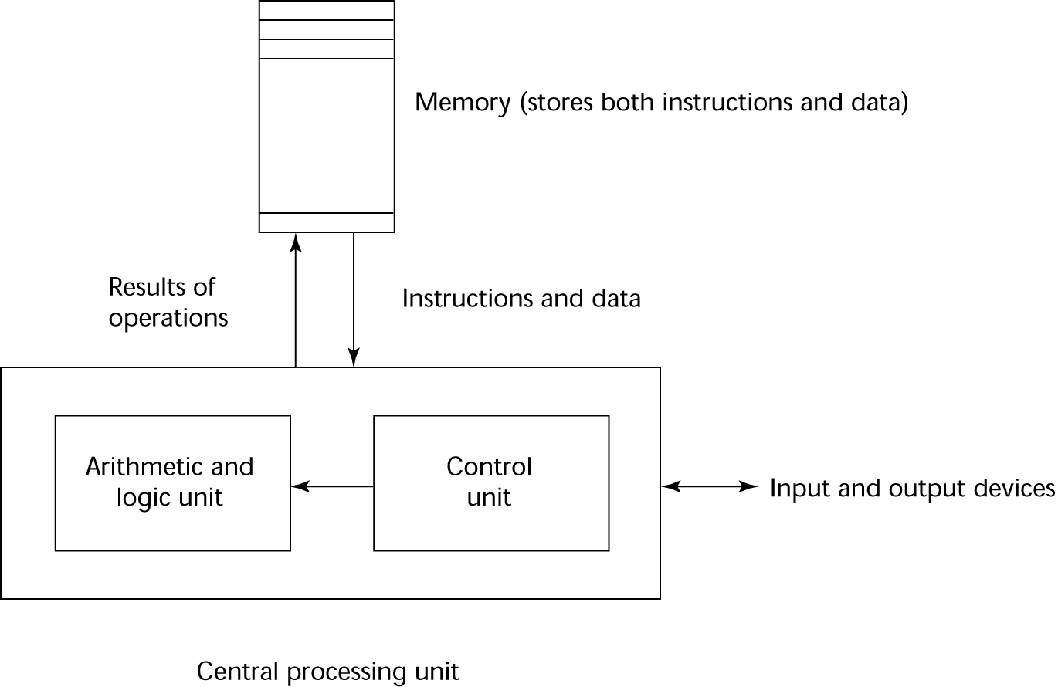
the von neumann architecture
Influences on Language Design: Computer Architecture

Slide 17
Influences on Language Design: Programming Methodologies
1950s and early 1960s: Simple applications; worry about machine efficiency
Late 1960s: People efficiency became important; readability, better control structures
structured programming
top-down design and step-wise refinement
Late 1970s: Process-oriented to data-oriented
data abstraction
Middle 1980s: Object-oriented programming
Data abstraction + inheritance + polymorphism

Slide 18
Language Categories
Imperative
Central features are variables, assignment statements, and iteration
Examples: C, Pascal
Functional
Main means of making computations is by applying functions to given parameters
Examples: LISP, Scheme
Logic
Rule-based (rules are specified in no particular order)
Example: Prolog
Object-oriented
Data abstraction, inheritance, late binding
Examples: Java, C++
Markup
New; not a programming per se, but used to specify the layout of information in Web documents
Examples: XHTML, XML

Slide 19
Language Design Trade-Offs
Reliability vs. cost of execution
Conflicting criteria
Example: Java demands all references to array elements be checked for proper indexing but that leads to increased execution costs
Readability vs. writability
Another conflicting criteria
Example: APL provides many powerful operators (and a large number of new symbols), allowing complex computations to be written in a compact program but at the cost of poor readability
Writability (flexibility) vs. reliability
Another conflicting criteria
Example: C++ pointers are powerful and very flexible but not reliably used

Slide 20
Implementation Methods
Compilation
Programs are translated into machine language
Pure Interpretation
Programs are interpreted by another program known as an interpreter
Hybrid Implementation Systems
A compromise between compilers and pure interpreters
Preprocessors
Programs are processed immediately prior to compilation

Slide 21
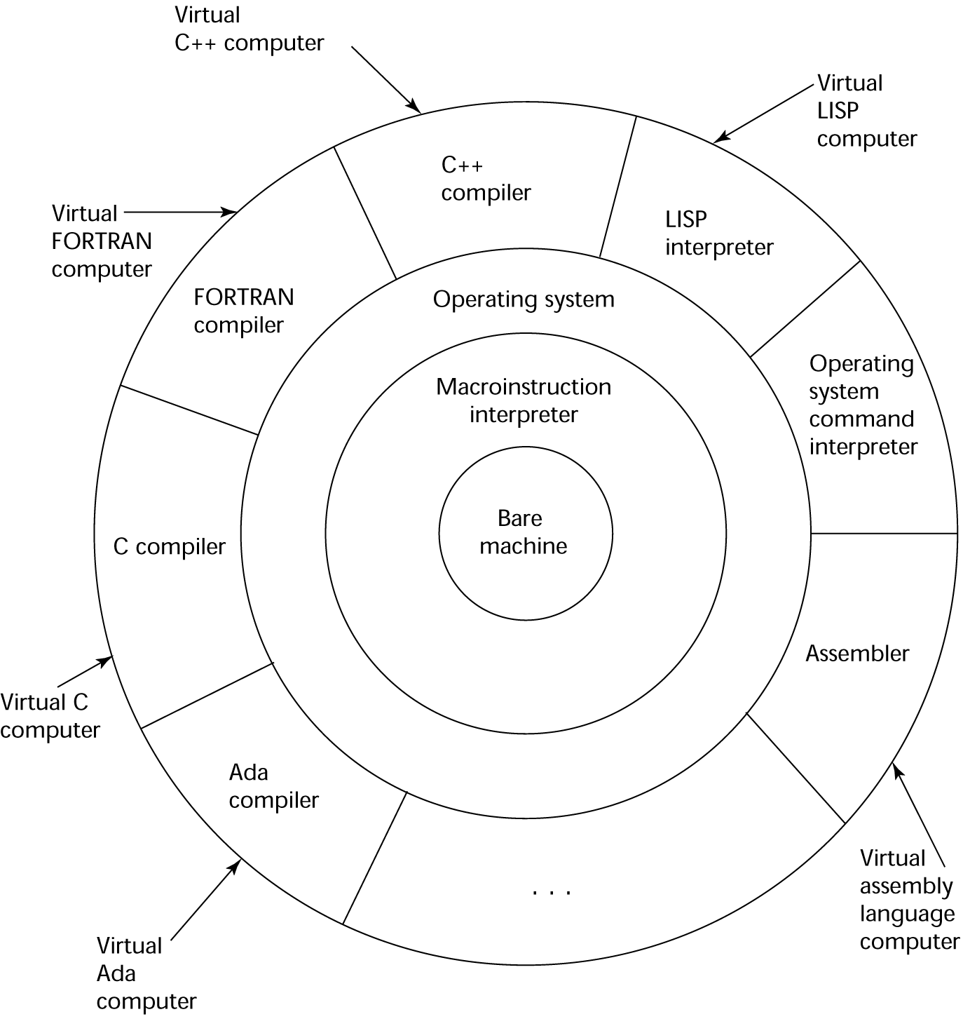
Implementation Methods
Virtual layered view of a typical computer system

Slide 22
Implementation Methods: Compilation
Translate high-level program (source language) into machine code (machine language)
Slow translation, fast execution
Phases of a compilation process:
lexical analysis: converts characters in the source program into lexical units
syntax analysis: transforms lexical units into parse trees which represent the syntactic structure of program
Intermediate code generator: generate intermediate code
Semantics analysis: checks for errors unidentifiable during the previous phases
Optimisation: improves program (often optional)

Slide 23
Implementation Methods: Compilation
Phases of a compilation process (continued):
Code generation: translate (optimised) intermediate code into equivalent machine code
Once compiled, the machine code produced often requires programs from the operating system in order to run. A linker links them together to produce a load module. A linker also links user program with previously compiler (user) programs.

Slide 24
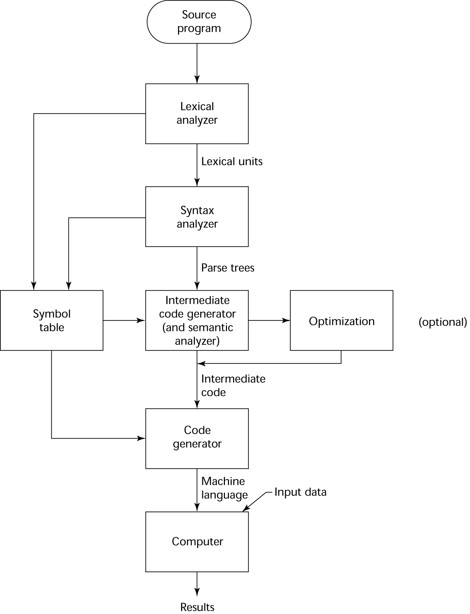
Implementation Methods: Compilation

Slide 25
Implementation Methods: Compilation
An issue to be considered in compilation is the von Neumann bottleneck, which is referring to the connection between a computer’s memory and its processor
The fact that program instructions can often be executed a lot faster than they (the instructions) can be moved to the processor for execution causes bottleneck.
Hence, this connection is the primary limiting factor in the speed of von Neumann architecture computers.

Slide 26
Implementation Methods: Pure Interpretation
No translation
Easier implementation of programs (run-time errors can easily and immediately displayed)
Slower execution (10 to 100 times slower than compiled programs)
Often requires more space
Becoming rare on high-level languages
Significant comeback with some Web scripting languages (e.g., JavaScript)

Slide 27
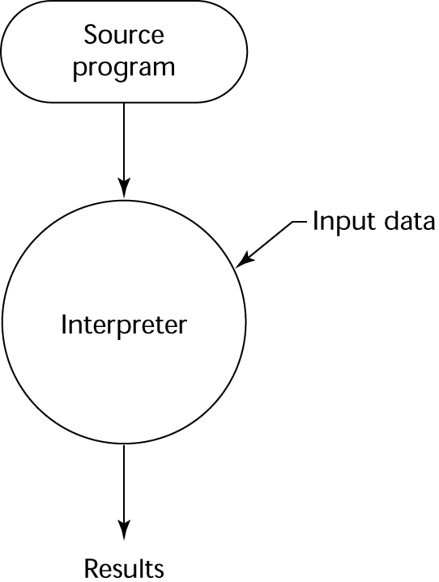
Implementation Methods: Pure Interpretation

Slide 28
Implementation Methods: Hybrid Implementation
A compromise between compilers and pure interpreters
A high-level language program is translated to an intermediate language that allows easy interpretation
Faster than pure interpretation
Examples
Perl programs are partially compiled to detect errors before interpretation
Initial implementations of Java were hybrid; the intermediate form, byte code, provides portability to any machine that has a byte code interpreter and a run-time system (together, these are called Java Virtual Machine)

Slide 29
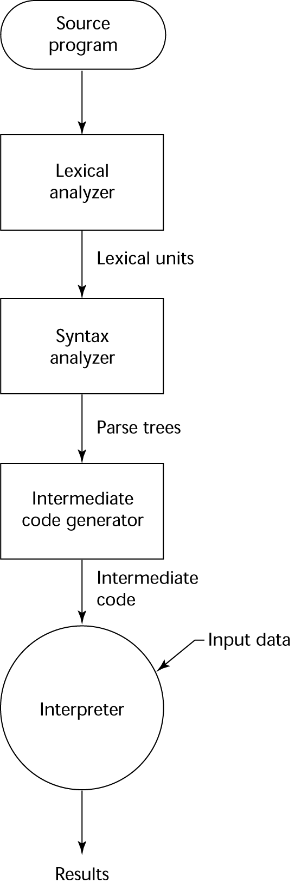
Implementation Methods: Hybrid Implementation

Slide 30
Implementation Methods: Hybrid Implementation
https://www.youtube.com/watch?v=qaj7nO1HUqA

Slide 31
Implementation Methods: Preprocessors
A program that processes a program immediately before it is compiled
Preprocessor macros (instructions) are commonly used to specify that code from another file is to be included
A preprocessor processes a program immediately before the program is compiled to expand embedded preprocessor macros
A well-known example: C preprocessor
expands #include, #define, and similar macros

Slide 32
Programming Environments
The collection of tools used in software development
UNIX
An older operating system and tool collection
Nowadays often used through a GUI (e.g., CDE, KDE, or GNOME) that run on top of UNIX
Borland JBuilder
An integrated development environment for Java
Microsoft Visual Studio.NET
A large, complex visual environment
Used to program in C#, Visual BASIC.NET, Jscript, J#, or C++

Slide 33
Summary
The study of programming languages is valuable for a number of reasons including:
Increase our capacity to use different constructs
Enable us to choose languages more intelligently
Makes learning new languages easier
Most important criteria for evaluating programming languages are:
Readability, writability, reliability, cost
Major influences on language design have been machine architecture and software development methodologies
The major methods of implementing programming languages are: compilation, pure interpretation, hybrid implementation and preprocessor

Slide 34
Chapter 2(1)
Describing Syntax and Semantics

Slide 35
Topics
Introduction
The General Problem of Describing Syntax
Formal Methods of Describing Syntax
Attribute Grammars
Describing the Meanings of Programs: Dynamic Semantics

Slide 36
Introduction
Syntax: the form or structure of the expressions, statements, and program units
Semantics: the meaning of the expressions, statements, and program units
Eg.
if (condition)
statement1
else
statement 2

Slide 37
The General Problem of Describing Syntax: Terminology
A sentence is a string of characters over some alphabet
A language is a set of sentences
A lexeme is the lowest level syntactic unit of a language, including
Numeric literals
Operators
Special words
A token is a category of lexemes, such as
Identifier
Arithmetic plus operator et cetera.

Slide 38
The General Problem of Describing Syntax: Terminology
Consider the following statement:
index = 2 * count + 17;
Lexemes Token
index identifier
= equal_sign
2 int_literal
* mult_op
count identifier
+ plus_op
17 int_literal
; semicolon

Slide 39
The General Problem of Describing Syntax: Terminology
2 distinct ways of defining a language:
Language recognizers
A recognition device reads input strings of the language and decides whether the input strings belong to the language
R(∑)= L?
Example: syntax analysis part of a compiler
Language generators
A device that generates sentences of a language
One can determine if the syntax of a particular sentence is correct by comparing it to the structure of the generator

Slide 40
Formal Methods of Describing Syntax
Context-Free Grammars (CFG)
Backus-Naur Form (BNF) and
Extended BNF

Slide 41
Formal Methods of Describing Syntax: CFG
Context-Free Grammars
Developed by Noam Chomsky, a noted linguist, in the mid-1950s
Two of the four generative devices (grammars), meant to describe the four classes of (natural) languages are found to be useful for describing the syntax of programming languages.
These are
Context-free grammars: describe the syntax of whole programming languages
Regular grammars: describe the forms of the tokens of programming languages

Slide 42
Formal Methods of Describing Syntax: BNF
Backus-Naur Form
A formal notation for specifying programming language syntax initially presented by John Backus to describe ALGOL 58 in 1959.
It was later modified slightly by Peter Naur to describe ALGOL 60, hence the Backus-Naur Form (BNF).
Most popular method for concisely describing programming language syntax

Slide 43
Formal Methods of Describing Syntax: BNF
BNF is a metalanguage for programming languages
It uses abstractions to represent classes of syntactic structures
An abstraction of a JAVA assignment statement:
<assign> → <var> = <expression>
A rule
The left-hand side (LHS) i.e. the abstraction being defined
The right-hand side (RHS) i.e. the definition of the LHS

Slide 44
Formal Methods of Describing Syntax: BNF
A possible instantiation of the previous rule is:
total = subtotal1 + subtotal2
The RHS, i.e. the definition can be a mixture of
tokens
lexemes and
references to other abstractions

Slide 45
Formal Methods of Describing Syntax: BNF
BNF abstractions are often called the non-terminal symbols or in short the nonterminals.
Likewise, the lexemes and tokens are called the terminal symbols or the terminals.
BNF grammar is therefore a collection of rules.

Slide 46
Formal Methods of Describing Syntax: BNF
Nonterminals can have two or more distinct definitons.
Consider another example of BNF rules:
<if_stmt> → if (<logic_expr>) <stmt>
<if_stmt> → if (<logic_expr>) <stmt> else <stmt>
which, can also be written as a single rule separated by the | symbol to mean logical OR.
<if_stmt> → if (<logic_expr>) <stmt>
| if (<logic_expr>) <stmt> else <stmt>

Slide 47
Formal Methods of Describing Syntax: BNF
BNF uses recursion to describe lists of syntactic elements in programming languages.
A rule is recursive if its LHS appears in its RHS. For example:
<ident_list> → identifier
| identifier, <ident_list>

Slide 48
Formal Methods of Describing Syntax: BNF
Derivation is a process of generating sentences through repeated application of rules, starting with the start symbol.
Consider the following BNF grammar:
<program> → begin <stmt_list> end
<stmt_list> → <stmt>
| <stmt>; <stmt_list>
<stmt> → <var> = <expression>
<var> → A | B | C
<expression> → <var> + <var>
| <var> - <var>
| <var>

Slide 49
Formal Methods of Describing Syntax: BNF
A derivation of the previous grammar is:
<program> => begin <stmt_list> end
=> begin <stmt>; <stmt_list> end
=> begin <var> = <expression>; <stmt_list> end
=> begin A = <expression>; <stmt_list> end
=> begin A = <var> + <var>; <stmt_list> end
=> begin A = B + <var>; <stmt_list> end
=> begin A = B + C; <stmt_list> end
=> begin A = B + C; <stmt> end
=> begin A = B + C; <var> = <expression> end
=> begin A = B + C; B = <expression> end
=> begin A = B + C; B = <var> end
=> begin A = B + C; B = C end

Slide 50
Formal Methods of Describing Syntax: BNF
Every string in the derivation is called a sentential form
A sentence is a sentential form that has only terminal symbols
Previous derivation is called leftmost derivation, where the leftmost nonterminal in each sentential form is expanded.
A rightmost derivation is also possible, neither leftmost nor rightmost derivation is also possible.
It is not possible to exhaustively generate all possible sentences in finite time.

Slide 51
Formal Methods of Describing Syntax: BNF
Exercise: Create a derivation from this grammar
<assign> → <id> = <expr>
<id> → A | B | C
<expr> → <id> + <expr>
|<id> * <expr>
| ( <expr> )
|<id>

Slide 52
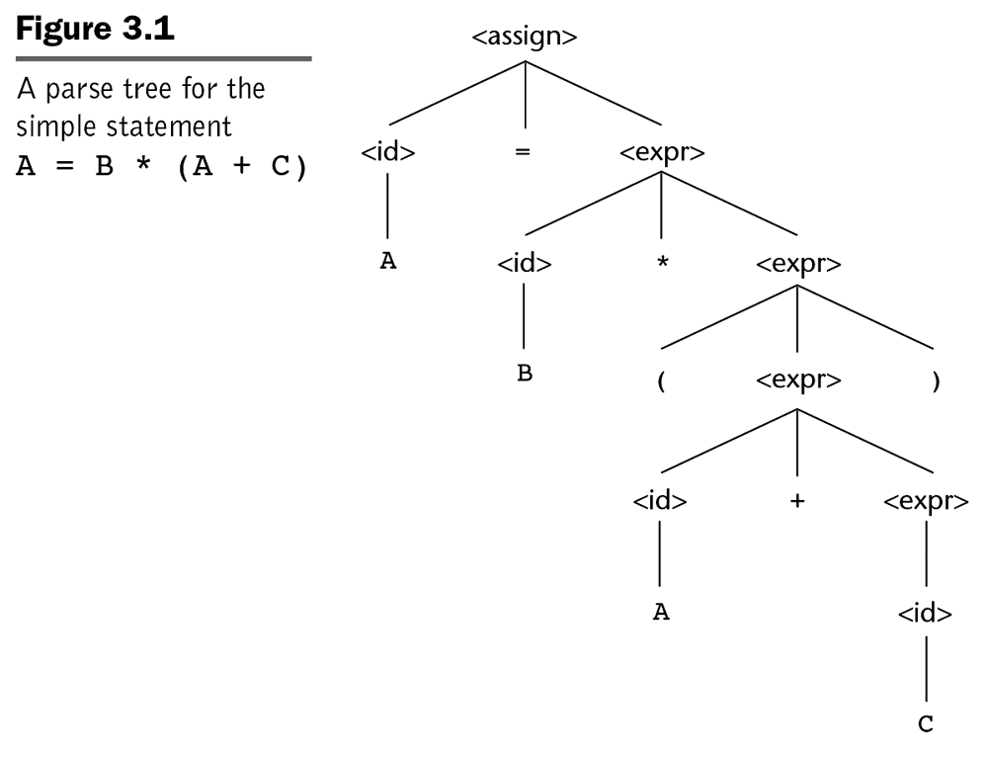
Formal Methods of Describing Syntax: BNF
Parse tree is a hierarchical syntactic structure of a derived sentence.

Slide 53
Formal Methods of Describing Syntax: BNF
Every internal node of a parse tree is labeled with a nonterminal symbol.
Every leaf is labeled with a terminal symbol.
Every subtree of a parse tree describes one instance of an abstraction in the sentence.

Slide 54
Formal Methods of Describing Syntax: BNF
A grammar is ambiguous if it generates a sentential form that has two or more distinct parse trees.
Consider the following BNF grammar:
<assign> → <id> = <expr>
<id> → A | B | C
<expr> → <expr> + <expr>
| <expr> * <expr>
| ( <expr> )
|<id>

Slide 55
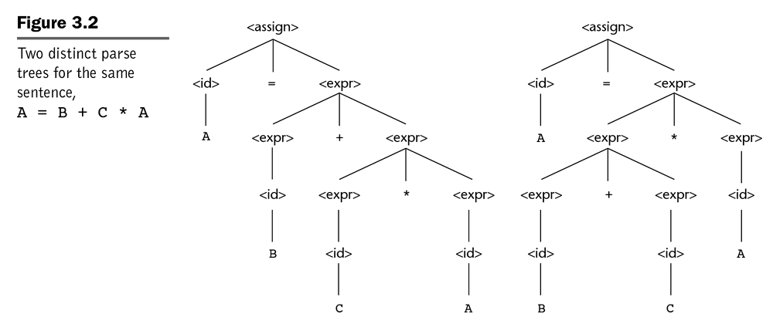
Formal Methods of Describing Syntax: BNF

Slide 56
Formal Methods of Describing Syntax: BNF
Solutions to ambiguity:
Operator precedence
Assigning different precedence levels to operators
Associativity of operators
Specifies ‘precedence’ of two operators that have the same precedence level.

Slide 57
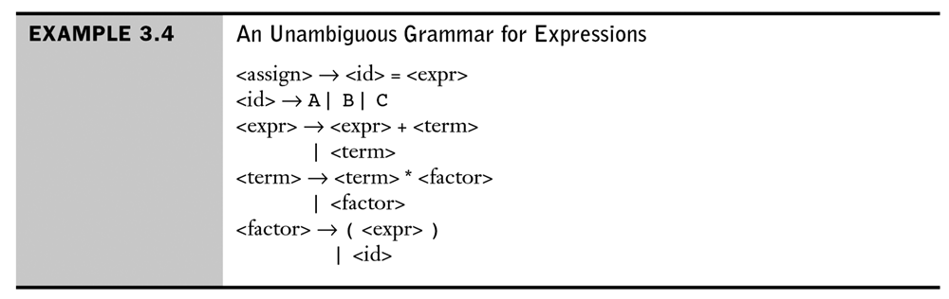
Formal Methods of Describing Syntax: BNF
An example of an unambiguous grammar that defines operator precedence:

Slide 58
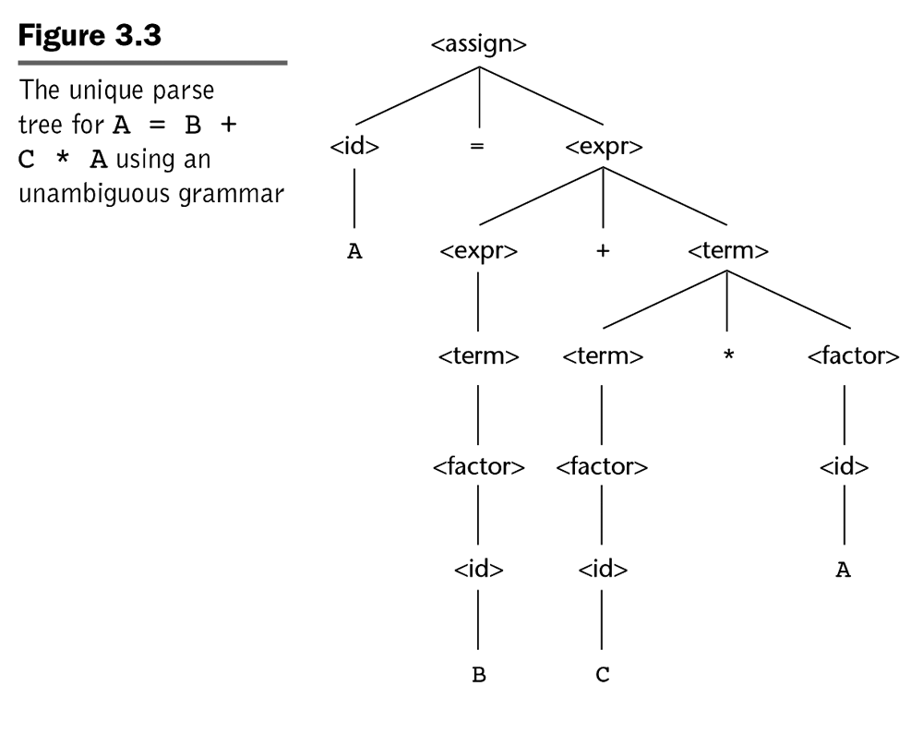
Formal Methods of Describing Syntax: BNF

Slide 59
Formal Methods of Describing Syntax: BNF
A rule is said to be left recursive if its LHS is also appearing at the beginning of its RHS.
Likewise, a grammar rule is right recursive if the LHS appears at the right end of the RHS.
<factor> → <exp> ** <factor>
| <exp>
<exp> → ( <expr> )
| id

Slide 60
Formal Methods of Describing Syntax: Extended BNF
Improves readability and writability of BNF
Three common extensions are:
Optional parts of an RHS, delimited by square brackets. E.g.
EBNF Format
<if_stmt> → if (<logic_expr>) <stmt> [else<stmt>]
BNF Format
<if_stmt> → if (<logic_expr>) <stmt>
| if (<logic_expr>) <stmt> else <stmt>

Slide 61
Formal Methods of Describing Syntax: Extended BNF
The use of curly braces in an RHS to indicate that the enclosed part can be repeated indefinitely or left out altogether.
EBNF Format
<ident_list> → <identifier> {, <identifier>}
BNF Format
<ident_list> → identifier
| identifier, <ident_list>

Slide 62
Formal Methods of Describing Syntax: Extended BNF
For multiple choice options, the options are placed inside parentheses and separated by the OR operator.
EBNF Format
<term> → <term> (*|/|%) <factor>
BNF Format
<term> → <term> * <factor>
| <term> / <factor>
| <term> % <factor>

Slide 63
Formal Methods of Describing Syntax: Extended BNF
BNF
<expr> → <expr> + <term>
| <expr> - <term>
| <term>
<term> → <term> * <factor>
| <term> / <factor>
| <factor>
<factor> → <exp> ** <factor>
| <exp>
<exp> → ( <expr> )
| id

Slide 64
Formal Methods of Describing Syntax: Extended BNF
EBNF
<expr> → <term> {(+ | -) <term>}
<term> → <factor> {(* | /) <factor>}
<factor> → <exp> {** <exp>}
<exp> → ( <expr> )
| id

Slide 65
Formal Methods of Describing Syntax: Extended BNF
Other variations of EBNF:
Numeric superscript attached to the right curly brace to indicate repetition upper limit.
A plus (+) superscript to indicate one or more repetition.
A colon used in place of the arrow and the RHS is moved to the next line.
Alternative RHSs are separated by new line rather than vertical bar.
Subscript opt is used to indicate something being optional rather than square brackets.
Et cetera …

Slide 66
Attribute Grammars
An extension to CFG that allows some characteristics of the structure of programming languages that are either difficult or impossible to be described using BNF.
Difficult e.g. type compatibility
Impossible e.g. all variable must be declared before they are referenced.
Therefore, the need for static semantic rules e.g. attribute grammars.
The additions are:
attributes
attribute computation functions
predicate functions

Slide 67
Attribute Grammars: Definition
Associated with each grammar symbol X is a set of attributes A(X).
The set A(X) consists of two disjoint sets,
S(X), synthesised attributes, used to pass semantic information up a parse tree and
I(X), inherited attributes, used to pass semantic information down and across a tree.

Slide 68
Attribute Grammars: Definition
Associated with each grammar rule is a set of semantic functions and a possibly empty set of predicate functions over the attributes of the symbols in the grammar rule.
For a rule X₀ → X₁ ... X_{n}, the synthesised attributes of X₀ are computed with semantic functions of the form:
S(X₀) = f(A(X₁), ... , A(X_{n}))
Likewise, inherited attributes of symbols X_{j}, 1 ≤ j ≤ n are computed with a semantic function of the form:
I(X_{j}) = f(A(X₀), ... , A(X_{n}))

Slide 69
Attribute Grammars: Definition
A predicate function has the form of a Boolean expression on the union of the attribute set {A(X₀), …, A(X_{n})}
The only derivations allowed with an attribute grammar are those in which every predicate associated with every nonterminal is true.
Intrinsic attributes are synthesised attributes of leaf nodes whose values are determined outside the parse tree

Slide 70
Attribute Grammars: Example
Syntax rule:
<proc_def> → procedure <proc_name>[1] <proc_body> end <proc_name>[2];
Predicate:
<proc_name>[1].string == <proc_name>[2].string
I.e. the predicate rule states that the name string attribute of the <proc_name> nonterminal in the subprogram header must match the name string attribute of the <proc_name> nonterminal following the end of the subprogram.

Slide 71
Attribute Grammars: Example
Consider the following grammar
<assign> → <var> = <expr>
<expr> → <var> + <var>
| <var>
<var> → A | B | C

Slide 72
Attribute Grammars: Example
And the following requirements …
The variables can be one of two types, int or real
When there are two variables on the right side of an assignment, they need not be the same type
The type of the expression when the operand types are not the same is always real
When they are the same, the expression type is that of the operands.
The type of the left side of the assignment must match the type of the right side
So, the types of operands in the right side can be mixed, but the assignment is valid only if the target and the value resulting from evaluating the right side have the same type.

Slide 73
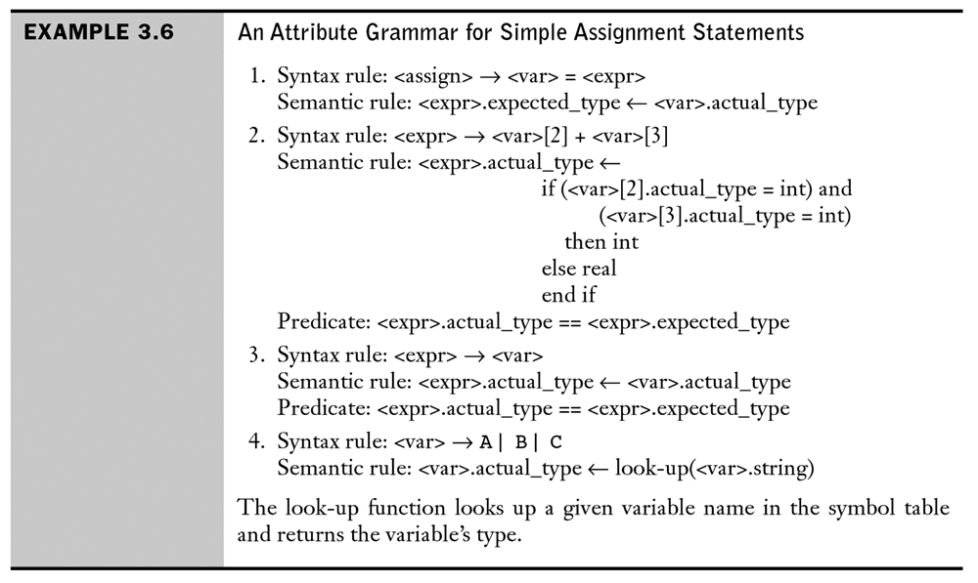
Attribute Grammars: Example

Slide 74
Attribute Grammars: Example
<assign>
<expr>
<var>
<var>[2]
<var>[3]
A
=
A
+
B

Slide 75
Attribute Grammars: Computing Attribute Values
If all attributes were inherited, the tree could be decorated in top-down order.
If all attributes were synthesized, the tree could be decorated in bottom-up order.
In many cases, both kinds of attributes are used, and it is some combination of top-down and bottom-up orders. E.g.:
<var>.actual_type ← look-up(A) (Rule 4)
<expr>.expected_type ← <var>.actual_type (Rule 1)
<var>[2].actual_type ← look-up(A) (Rule 4)
<var>[3].actual_type ← look-up(B) (Rule 4)
<expr>.actual_type ← either int or real (Rule 2)
<expr>.expected_type == <expr>.actual_type is either TRUE or FALSE (Rule 2)

Slide 76
Attribute Grammars: Computing Attribute Values
<assign>
expected_type
<expr>
actual_type
<var>
actual_type
<var>[2]
actual_type
<var>[3]
actual_type
A
=
A
+
B

Slide 77
Attribute Grammars: Computing Attribute Values
<assign>
expected_type
<expr>
actual_type
expected_type=real_type
actual_type= real_type
actual_type= real_type
<var>
actual_type= real_type
<var>[2]
actual_type
<var>[3]
actual_type
actual_type= int_type
A
=
A
+
B

Slide 78
Chapter 2(2)
Describing Syntax and Semantics

Slide 79
Dynamic Semantics
Describing syntax is relatively simple
There is no single widely acceptable notation or formalism for describing semantics
If there were a precise semantics specification of a programming language, programs written in the language potentially could be proven correct without testing, correctness of compilers could be verified.

Slide 80
Approaches in (dynamic) semantics
Operational Semantics
Describe the meaning of a program by executing its statements on a machine, either simulated or actual. The change in the state of the machine (memory, registers, etc.) defines the meaning of the statement
Denotational semantics
Using mathematical and logic approach.
Axiomatic Semantics
Specifies what can be proven about the program, rather than directly specifying the meaning of a program.

Slide 81
Operational Semantics
To describe the meaning of a statement or program by specifying the effects of running it on a machine.
Machine language shows sequence of changes in state, but problems to be used as formal description:
Too small and too numerous of individual steps in machine language
Too large and complex storage architecture
Different levels of uses:
At highest level, use with interest in the final result (natural ops. Semantics).
At lowest level, to determine the precise meaning of program (structural ops. Semantics)

Slide 82
Operational Semantics (continued)
The basic process:
Design appropriate intermediate language that is clear and unambiguous

Slide 83
Operational Semantics (continued)
C statement
for ( expr1; expr2; expr3) {
…;
…;
}
Meaning :
expr1;
loop : if expr2 == 0 goto out
…
expr3;
goto loop
out : …

Slide 84
Operational Semantics (continued)
Evaluation of operational semantics:
Good if used informally (language manuals, etc.)
Extremely complex if used formally (e.g., VDL), it was used for describing semantics of PL/I.
Provides an effective means of describing semantics for language users and language implementers – as long as the descriptions are kept simple and informal.
Depends on programming language of lower level, not mathematics – the statement of one programming language are described in terms of the statements of a lower-level programming language.

Slide 85
Denotational Semantics
Based on recursive function theory
The most abstract semantics description method
Originally developed by Scott and Strachey (1970)

Slide 86
Denotational Semantics (continued)
The process of building a denotational specification for a language
Define a mathematical object for each language entity
Define a function that maps instances of the language entities onto instances of the corresponding mathematical objects
The meaning of language constructs are defined by only the values of the program's variables

Slide 87
Denotational Semantics versus Operational Semantics
In operational semantics, the state changes are defined by coded algorithms
In denotational semantics, the state changes are defined by rigorous mathematical functions

Slide 88
Denotational semantics example
The following rule to describe the binary number
<bin_num> → ‘0’
| ‘1’
| <bin_num> ‘0’
| <bin_num> ‘1’
A parse tree for the example binary number, 110,

Slide 89
Denotational semantics example
The following rule to describe the binary number of a decimal number
Mbin('0') = 0
Mbin('1') = 1
Mbin(<bin_num> '0') = 2 * Mbin(<bin_num>)
Mbin(<bin_num> '1') = 2 * Mbin(<bin_num>) + 1
Example the decimal number 6

Slide 90
Denotational semantics example
<dec_num> → 0 | 1 | 2 | 3 | 4 | 5 | 6 | 7 | 8 | 9
| <dec_num> (0 | 1 | 2 | 3 | 4 | 5 | 6 | 7 | 8 | 9)
M_{dec}('0') = 0, M_{dec} ('1') = 1, …, M_{dec} ('9') = 9
M_{dec} (<dec_num> '0') = 10 * M_{dec} (<dec_num>)
M_{dec} (<dec_num> '1’) = 10 * M_{dec} (<dec_num>) + 1
…
M_{dec} (<dec_num> '9') = 10 * M_{dec} (<dec_num>) + 9

Slide 91
Denotational Semantics: Program State
The state of a program is the values of all its current variables
s = {<i₁, v₁>, <i₂, v₂>, …, <i_{n}, v_{n}>}
Let VARMAP be a function that, when given a variable name and a state, returns the current value of the variable
VARMAP(i_{j}, s) = v_{j}

Slide 92
Expressions
Map expressions onto Z ∪ {error}
We assume expressions are decimal numbers, variables, or binary expressions having one arithmetic operator and two operands, each of which can be an expression

Slide 93
Expressions
Describe the semantics of the following BNF:
<expr> → <dec_num> | <var> | <binary_expr>
<binary_expr> → <left_expr> <operator> <right_expr>
<left_expr> → <dec_num> | <var>
<right_expr> → <dec_num> | <var>
<operator> → + | *

Slide 94
Semantics (cont.)
M_{e}(<expr>, s) Δ=
case <expr> of
<dec_num> => M_{dec}(<dec_num>, s)
<var> =>
if VARMAP(<var>, s) == undef
then error
else VARMAP(<var>, s)
<binary_expr> =>
if (M_{e}(<binary_expr>.<left_expr>, s) == undef
OR M_{e}(<binary_expr>.<right_expr>, s) =
undef)
then error
else
if (<binary_expr>.<operator> == ‘+’ then
M_{e}(<binary_expr>.<left_expr>, s) +
M_{e}(<binary_expr>.<right_expr>, s)
else M_{e}(<binary_expr>.<left_expr>, s) *
M_{e}(<binary_expr>.<right_expr>, s)
...

Slide 95
Assignment Statements
Maps state sets to state sets
Ma(x := E, s) Δ=
if Me(E, s) == error
then error
else s’ = {<i₁’,v₁’>,<i₂’,v₂’>,...,<i_{n}’,v_{n}’>},
where for j = 1, 2, ..., n,
if i_{j} == x
then v_{j} = Me(E, s)
else v_{j} = VARMAP(i_{j}, s)

Slide 96
Logical Pretest Loops
Maps state sets to state sets
M_{l}(while B do L, s) Δ=
if M_{b}(B, s) == undef
then error
else if M_{b}(B, s) == false
then s
else if M_{sl}(L, s) == error
then error
else M_{l}(while B do L, M_{sl}(L, s))

Slide 97
Loop Meaning
The meaning of the loop is the value of the program variables after the statements in the loop have been executed the prescribed number of times, assuming there have been no errors
In essence, the loop has been converted from iteration to recursion, where the recursive control is mathematically defined by other recursive state mapping functions
Recursion, when compared to iteration, is easier to describe with mathematical rigor

Slide 98
Evaluation of Denotational Semantics
Can be used to prove the correctness of programs
Provides a rigorous way to think about programs
Can be an aid to language design
Has been used in compiler generation systems
Because of its complexity, they are of little use to language users

Slide 99
Axiomatic Semantics
Based on formal mathematical logic
Original purpose: formal program verification – to prove the correctness of programs.
The meaning of a program is based on relationships among program variables and constants, which are the same for every execution of the program.
Two distinct applications:
Program verification
Semantics specification

Slide 100
Axiomatic Semantics (continued)
Axioms or inference rules are defined for each statement type in the language (to allow transformations of expressions to other expressions)
The expressions are called assertions
An assertion before a statement, a precondition, states the relationships and constraints among variables that are true at that point in execution
An assertion following a statement is a postcondition that describes the new constraints on those variables after execution of the statement
A weakest precondition is the least restrictive precondition that will guarantee the postcondition

Slide 101
Axiomatic Semantics Form
Pre-, post form: {P} statement {Q}
An example
a = b + 1 {a > 1}
One possible precondition: {b > 10}
Weakest precondition: {b > 0}

Slide 102
Program Proof Process
The postcondition for the entire program is the desired result
Work back through the program to the first statement. If the precondition on the first statement is the same as the program specification, the program is correct.

Slide 103
Proving assignment statements
The usual notation is
{P} S {Q}
E.g.
a = b / 2 – 1 {a < 10}
The weakest precondition is computed by substituting b / 2 – 1 for a in the postcondition {a < 10}.
b / 2 – 1 < 10
b < 22
Therefore, the weakest precondition is {b < 22}

Slide 104
Proving sequences
An inference rule for sequences
{P1} S1 {P2}
{P2} S2 {P3}
– antecedent
- consequent
If antecedent are true, then truth of consequent can be inferred

Slide 105
Proving sequences
For example, consider the following sequence and postcondition:
y = 3 * x + 1;
x = y + 3;
{x < 10}
The precondition for the second assignment statement is
y < 7
which is used as the postcondition for the first statement. The precondition for
the first assignment statement can now be computed:
3 * x + 1 < 7
x < 2
So, {x < 2} is the precondition of both the first statement and the twostatement
sequence.

Slide 106
Proving selection
An inference rule for selection
if B then S1 else s2
– antecedent
- consequent
The selection statement must be proven for both when the boolean expression is true and false.
We need a precondition P that can be used in the precondition of both the then and else clause.

Slide 107
Proving selection (continued)
Example
if x >0 then
y= y - 1
else
y= y + 1
Suppose Q is {y > 0}, using rule of consequence, the precondition for the whole statement is {y > 1}.

Slide 108
Proving Loop
An inference rule for logical pretest loops
The axiomatic description of a while loop is written as {P} while B do S end {Q}
where I is the loop invariant (the inductive hypothesis)

Slide 109
Proving Loop
E.g.
while y <> x do y = y + 1
Zero iteration, wp is obviously {y = x}
One iteration, wp is
y = y + 1, {y = x}) = {y + 1 = x}, or {y = x - 1}
Two iterations? Three iterations?
Therefore, {y <= x} is the precondition {P}

Slide 110
Proving Loop
Characteristics of the loop invariant: I must meet the following conditions:
P => I -- the loop invariant must be true initially
{I and B} S {I} -- I is not changed by executing the body of the loop
(I and (not B)) => Q -- if I is true and B is false, is implied
The loop terminates

Slide 111
Proving Loop
P => I
In this case, I is used as precondition. Because P = I, P => I.
{I and B} S {I}
{y <= x and y <> x} y = y + 1 {y <= x}
Applying the axiom to y = y + 1 {y <= x} we get {y + 1 <= x}, which is equivalent to {y < x}, which is implied by {y <= x and y <> x}
So, proven
(I and (not B)) => Q
{(y <= x and (not (y <> x)))} => {y = x}
{(y <=x and (y = x)) => {y = x}
{y = x} => {y = x}
The loop terminates
{y <= x} while y <> x do y = y + 1 end {y = x}

Slide 112
Proving Loop
The loop invariant I is a weakened version of the loop postcondition, and it is also a precondition.
I must be weak enough to be satisfied prior to the beginning of the loop, but when combined with the loop exit condition, it must be strong enough to force the truth of the postcondition

Slide 113
Evaluation of Axiomatic Semantics
Developing axioms or inference rules for all of the statements in a language is difficult
It is a good tool for correctness proofs, and an excellent framework for reasoning about programs, but it is not as useful for language users and compiler writers
Its usefulness in describing the meaning of a programming language is limited for language users or compiler writers

Slide 114
Summary
BNF and context-free grammars are equivalent meta-languages
Well-suited for describing the syntax of programming languages
An attribute grammar is a descriptive formalism that can describe both the syntax and the semantics of a language
Three primary methods of semantics description
Operation, axiomatic, denotational (others:
Domain theory and fixed point, Algebraic, Action & Translational Semantics

Slide 115
Chapter 3
Lexical and Syntax Analysis

Slide 116
Chapter 4 Topics
Introduction
Lexical Analysis
The Parsing Problem
Recursive-Descent Parsing
Bottom-Up Parsing

Slide 117
4.1 Introduction
Language implementation systems must analyze source code, regardless of the specific implementation approach (Compilation, Pure interpretation and JIT)
Nearly all syntax analysis is based on a formal description of the syntax of the source language (BNF)

Slide 118
Syntax Analysis
The syntax analysis portion of a language processor nearly always consists of two parts:
A low-level part called a lexical analyzer (mathematically, a finite automaton based on a regular grammar)
A high-level part called a syntax analyzer, or parser (mathematically, a push-down automaton based on a context-free grammar, or BNF)

Slide 119
Using BNF to Describe Syntax
Provides a clear and concise syntax description – contex free, can be used by human and softwares
The parser (syntax analyzer) can be based directly on the BNF
Parsers based on BNF are easy to maintain - modularity

Slide 120
Reasons to Separate Lexical and Syntax Analysis
Simplicity - less complex approaches can be used for lexical analysis; separating them simplifies the parser
Efficiency - separation allows optimization of the lexical analyzer
Portability - parts of the lexical analyzer may not be portable, but the parser always is portable

Slide 121
4.2 Lexical Analysis
A lexical analyzer is a pattern matcher for character strings
A lexical analyzer is a “front-end” for the parser
Identifies substrings of the source program that belong together - lexemes
Lexemes match a character pattern, which is associated with a lexical category called a token
sum is a lexeme; its token may be IDENT

Slide 122
Lexical Analysis (continued)
The lexical analyzer
Extracts lexemes from given input string and produce corresponding tokens
Syntax analyzer will only see the output of lexical analyzer (one lexeme at a time)
Skips comments and blanks
Inserts lexemes for user-defined names into symbol table – used by compiler
Detects syntactical errors in tokens

Slide 123
Lexical Analysis (continued)
The lexical analyzer is usually a function that is called by the parser when it needs the next token
Three approaches to building a lexical analyzer:
Write a formal description of the tokens and use a software tool that constructs table-driven lexical analyzers given such a description
Design a state diagram that describes the tokens and write a program that implements the state diagram
Design a state diagram that describes the tokens and hand-construct a table-driven implementation of the state diagram

Slide 124
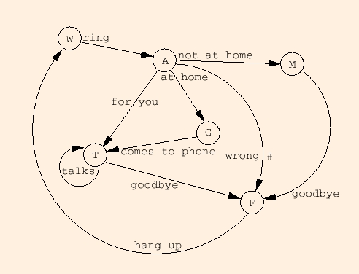
Example of a State Diagram

Slide 125
State Diagram Design
A naïve state diagram would have a transition from every state on every character in the source language - such a diagram would be very large!

Slide 126
Lexical Analysis (cont.)
In many cases, transitions can be combined to simplify the state diagram
When recognizing an identifier, all uppercase and lowercase letters are equivalent
Use a character class that includes all letters
When recognizing an integer literal, all digits are equivalent - use a digit class

Slide 127
Lexical Analysis (cont.)
Reserved words and identifiers can be recognized together (rather than having a part of the diagram for each reserved word)
Use a table lookup to determine whether a possible identifier is in fact a reserved word

Slide 128
Lexical Analysis (cont.)
Convenient utility subprograms:
getChar - gets the next character of input, puts it in nextChar, determines its class and puts the class in charClass
addChar - puts the character from nextChar into the place the lexeme is being accumulated, lexeme
lookup - determines whether the string in lexeme is a reserved word (returns a code)

Slide 129
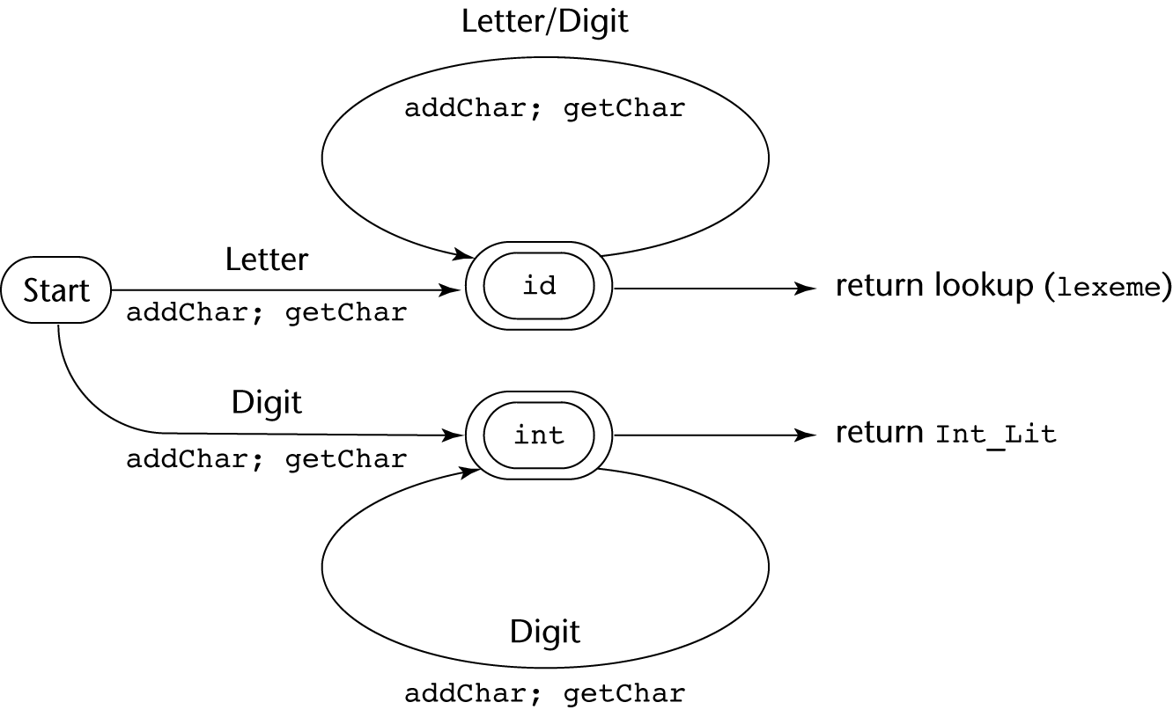
State Diagram

Slide 130
Implementation (assume initialization):
int lex() {
getChar();
switch (charClass) {
case LETTER:
addChar();
getChar();
while (charClass == LETTER || charClass == DIGIT)
{
addChar();
getChar();
}
return lookup(lexeme);
break;
case DIGIT:
addChar();
getChar();
while (charClass == DIGIT) {
addChar();
getChar();
}
return INT_LIT;
break;
} /* End of switch */
} /* End of function lex */

Slide 131
Parsing
Goals of the parser, given an input program:
Find all syntax errors; for each, produce an appropriate diagnostic message, and recover quickly
Produce the parse tree, or at least a trace of the parse tree, for the program

Slide 132
Parsing (cont.)
Notations used …
Lowercase letters at the beginning of the alphabet (a, b, …) for terminal symbols.
Uppercase letters at the beginning of the alphabet (A, B, …) for nonterminals symbols.
Uppercase letters at the end of the alphabet (W, X, Y, Z) for terminals or nonterminals.
Lowercase letters at the end of the alphabet (w, x, y, z) for strings of terminal.
Lowercase Greek letters (α, β, γ, δ) for mixed strings (terminals and/or nonterminals)

Slide 133
Parsing (cont.)
Two categories of parsers
Top down - produce the parse tree, beginning at the root
Order is that of a leftmost derivation
Traces or builds the parse tree in preorder
Bottom up - produce the parse tree, beginning at the leaves
Order is that of the reverse of a rightmost derivation
Parsers look only one token ahead in the input

Slide 134
Parsing (cont.)
Top-down Parsers
Given a sentential form, xAα , the parser must choose the correct A-rule to get the next sentential form in the leftmost derivation, using only the first token produced by A
The most common top-down parsing algorithms:
Recursive descent - a coded implementation
LL parsers - table driven implementation
A
bB
cbB
a

Slide 135
The Parsing Problem (cont.)
Bottom-up parsers
Given a right sentential form, α, determine what substring of α is the right-hand side of the rule in the grammar that must be reduced to produce the previous sentential form in the right derivation
The most common bottom-up parsing algorithms are in the LR family
Eg.
S → aAc
A → aA | b
S => aAc => aaAc => aabc

Slide 136
The Parsing Problem (cont.)
The Complexity of Parsing
Parsers that work for any unambiguous grammar are complex and inefficient ( O(n³), where n is the length of the input )
Compilers use parsers that only work for a subset of all unambiguous grammars, but do it in linear time ( O(n), where n is the length of the input )

Slide 137
Recursive-Descent Parsing
There is a subprogram for each nonterminal in the grammar, which can parse sentences that can be generated by that nonterminal
EBNF is ideally suited for being the basis for a recursive-descent parser, because EBNF minimizes the number of nonterminals

Slide 138
Recursive-Descent Parsing (cont.)
A grammar for simple expressions:
<expr> → <term> {(+ | -) <term>}
<term> → <factor> {(* | /) <factor>}
<factor> → id | ( <expr> )

Slide 139
Recursive-Descent Parsing (cont.)
Assume we have a lexical analyzer named lex, which puts the next token code in nextToken
The coding process when there is only one RHS:
For each terminal symbol in the RHS, compare it with the next input token; if they match, continue, else there is an error
For each nonterminal symbol in the RHS, call its associated parsing subprogram

Slide 140
Recursive-Descent Parsing (cont.)
void expr() {
term();
while (nextToken == PLUS_CODE || nextToken == MINUS_CODE){
lex();
term();
}
}
void term(){
factor();
while (nextToken == AST_CODE || nextToken == SLACH_CODE){
lex();
factor();
}
}
void factor() {
if (nextToken) == ID_CODE)
lex();
else if (nextToken == LEFT_PAREN_CODE) {
lex();
expr();
if (nextToken == RIGHT_PAREN_CODE)
lex();
else
error();
} /* End of else if (nextToken == ... */
else error(); /* Neither RHS matches */
}
<expr> → <term> {(+ | -) <term>}
<term> → <factor> {(* | /) <factor>}
<factor> → id | ( <expr> )

Slide 141
Recursive-Descent Parsing (cont.)
/* Function expr
Parses strings in the language generated by the rule:
<expr> → <term> {(+ | -) <term>}
*/
void expr() {
/* Parse the first term */
term();
/* As long as the next token is + or -, call lex to get the next token, and parse the next term */
while (nextToken == PLUS_CODE || nextToken == MINUS_CODE){
lex();
term();
}
}
This particular routine does not detect errors
Convention: Every parsing routine leaves the next token in nextToken

Slide 142
Recursive-Descent Parsing (cont.)
/* Function term
Parses string in the language generated by the rule: <term> -> <factor> {(*|/)<factor>}*/
void term(){
/*parse the first factor */
factor();
/*As long as the next token is * or /, call lex to get the next token, and parse the next facrtor*/
while (nextToken == AST_CODE || nextToken == SLACH_CODE){
lex();
factor();
}
}

Slide 143
Recursive-Descent Parsing (cont.)
A nonterminal that has more than one RHS requires an initial process to determine which RHS it is to parse
The correct RHS is chosen on the basis of the next token of input (the lookahead)
The next token is compared with the first token that can be generated by each RHS until a match is found
If no match is found, it is a syntax error

Slide 144
Recursive-Descent Parsing (cont.)
/* Function factor
Parses strings in the language generated by the rule:
<factor> -> id | (<expr>) */
void factor() { /* Determine which RHS */
if (nextToken) == ID_CODE) /* For the RHS id, just call lex */
lex();
/* If the RHS is (<expr>) – call lex to pass over the left parenthesis, call expr, and check for the right parenthesis */
else if (nextToken == LEFT_PAREN_CODE) {
lex();
expr();
if (nextToken == RIGHT_PAREN_CODE)
lex();
else
error();
} /* End of else if (nextToken == ... */
else error(); /* Neither RHS matches */
}

Slide 145
Recursive-Descent Parsing (cont.)
The LL Grammar Class
The Left Recursion Problem
If a grammar has left recursion, either direct or indirect, it cannot be the basis for a top-down parser
A grammar can be modified to remove left recursion
Direct
A → A + B………….
Indirect
A → B a A
B → A b

Slide 146
Recursive-Descent Parsing (cont.)
The LL Grammar Class
The Left Recursion Problem
If a grammar has left recursion, either direct or indirect, it cannot be the basis for a top-down parser
A grammar can be modified to remove left recursion
A → Aα |β left recursion rule
Sol:
A → βA’
A’ → αA’| ε ε is the null value

Slide 147
Recursive-Descent Parsing (cont.)
The LL Grammar Class
The Left Recursion Problem
E → E + T| T
T→ T * F | F
F → (E) | id
E → T E’
E’ → + T E’|ε ε is the null value
T→ F T’
T’ → * F T’| ε
F → (E) id
A → Aα |β
A → βA’
A’ → αA’| ε

Slide 148
Recursive-Descent Parsing (cont.)
The other characteristic of grammars that disallows top-down parsing is the lack of pairwise disjointness
The inability to determine the correct RHS on the basis of one token of lookahead
Def: FIRST(α) = {a | α =>* aβ }
(If α =>* ε, ε is in FIRST(α))

Slide 149
Recursive-Descent Parsing (cont.)
Pairwise Disjointness Test:
For each nonterminal, A, in the grammar that has more than one RHS, for each pair of rules, A → α_{i} and A → α_{j}, it must be true that
FIRST(α_{i}) ∩ FIRST(α_{j}) = φ
Examples:
A → aA | bB - pass the test
A → aA | aB - fail the test
SOL:
A → aA’
A’ → A|B
A → aA | a - fail the test
SOL:
A → aA’
A’ → A| ε ε is the null value

Slide 150
Recursive-Descent Parsing (cont.)
Left factoring can resolve the problem
Replace
<variable> → identifier | identifier [<expression>]
with
<variable> → identifier <new>
<new> → ε | [<expression>]
or
<variable> → identifier [[<expression>]]
(the outer brackets are metasymbols of EBNF)

Slide 151
Recursive-Descent Parsing (cont.)
Left factoring can resolve the problem
s →a|ab|abc|abcd
Sol:
s → as’
s’ → ε|bs’’ ε is the null value
s’’ → ε|cs’’’
s’’’ → ε|d

Slide 152
Bottom-up Parsing
The parsing problem is finding the correct RHS in a right-sentential form (handle) to reduce to get the previous right-sentential form in the derivation
Example grammar:
E → E + T | T
T → T * F | F
F → ( E ) | id (1)
E.g. derived sentence: id + id * id

Slide 153
Bottom-up Parsing (cont.)
Intuition about handles:
Def: β is the handle of the right sentential form
γ = αβw if and only if S =>*_{rm} αAw =>_{rm} αβw
Def: β is a phrase of the right sentential form
γ if and only if S =>* γ = α₁Aα₂ =>+ α₁βα₂
Def: β is a simple phrase of the right sentential form γ if and only if S =>* γ = α₁Aα₂ => α₁βα₂

Slide 154
Bottom-up Parsing (cont.)
Intuition about handles:
The handle of a right sentential form is its leftmost simple phrase
Given a parse tree, it is now easy to find the handle
Parsing can be thought of as handle pruning

Slide 155
Bottom-up Parsing (cont.)
Shift-Reduce Algorithms
Reduce is the action of replacing the handle on the top of the parse stack with its corresponding LHS
Shift is the action of moving the next token to the top of the parse stack

Slide 156
Bottom-up Parsing (cont.)
Advantages of LR parsers:
They will work for nearly all grammars that describe programming languages.
They work on a larger class of grammars than other bottom-up algorithms, but are as efficient as any other bottom-up parser.
They can detect syntax errors as soon as it is possible.
The LR class of grammars is a superset of the class parsable by LL parsers.

Slide 157
Bottom-up Parsing (cont.)
LR parsers must be constructed with a tool
Knuth’s insight: A bottom-up parser could use the entire history of the parse, up to the current point, to make parsing decisions
There were only a finite and relatively small number of different parse situations that could have occurred, so the history could be stored in a parser state, and stored in the parse stack

Slide 158
Bottom-up Parsing (cont.)
An LR configuration stores the state of an LR parser
(S₀X₁S₁X₂S₂…X_{m}S_{m}, a_{i}a_{i}+1…a_{n}$)

Slide 159
Bottom-up Parsing (cont.)
LR parsers are table driven, where the table has two components, an ACTION table and a GOTO table
The ACTION table specifies the action of the parser, given the parser state and the next token
Rows are state names; columns are terminals
The GOTO table specifies which state to put on top of the parse stack after a reduction action is done
Rows are state names; columns are nonterminals

Slide 160
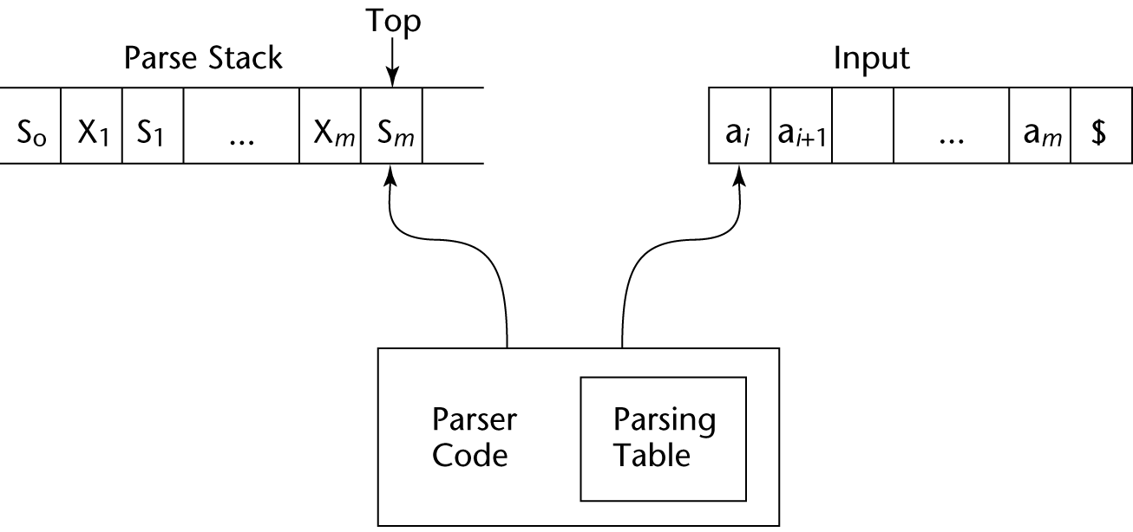
Structure of An LR Parser

Slide 161
Bottom-up Parsing (cont.)
Initial configuration: (S₀, a₁…a_{n}$)
Parser actions:
If ACTION[S_{m}, a_{i}] = Shift S, the next configuration is:
(S₀X₁S₁X₂S₂…X_{m}S_{m}a_{i}S, a_{i+1}…a_{n}$)
If ACTION[S_{m}, a_{i}] = Reduce A → β and S = GOTO[S_{m-r}, A], where r = the length of β, the next configuration is
(S₀X₁S₁X₂S₂…X_{m-r}S_{m-r}AS, a_{i}a_{i+1}…a_{n}$)

Slide 162
Bottom-up Parsing (cont.)
Parser actions (continued):
If ACTION[S_{m}, a_{i}] = Accept, the parse is complete and no errors were found.
If ACTION[S_{m}, a_{i}] = Error, the parser calls an error-handling routine.

Slide 163
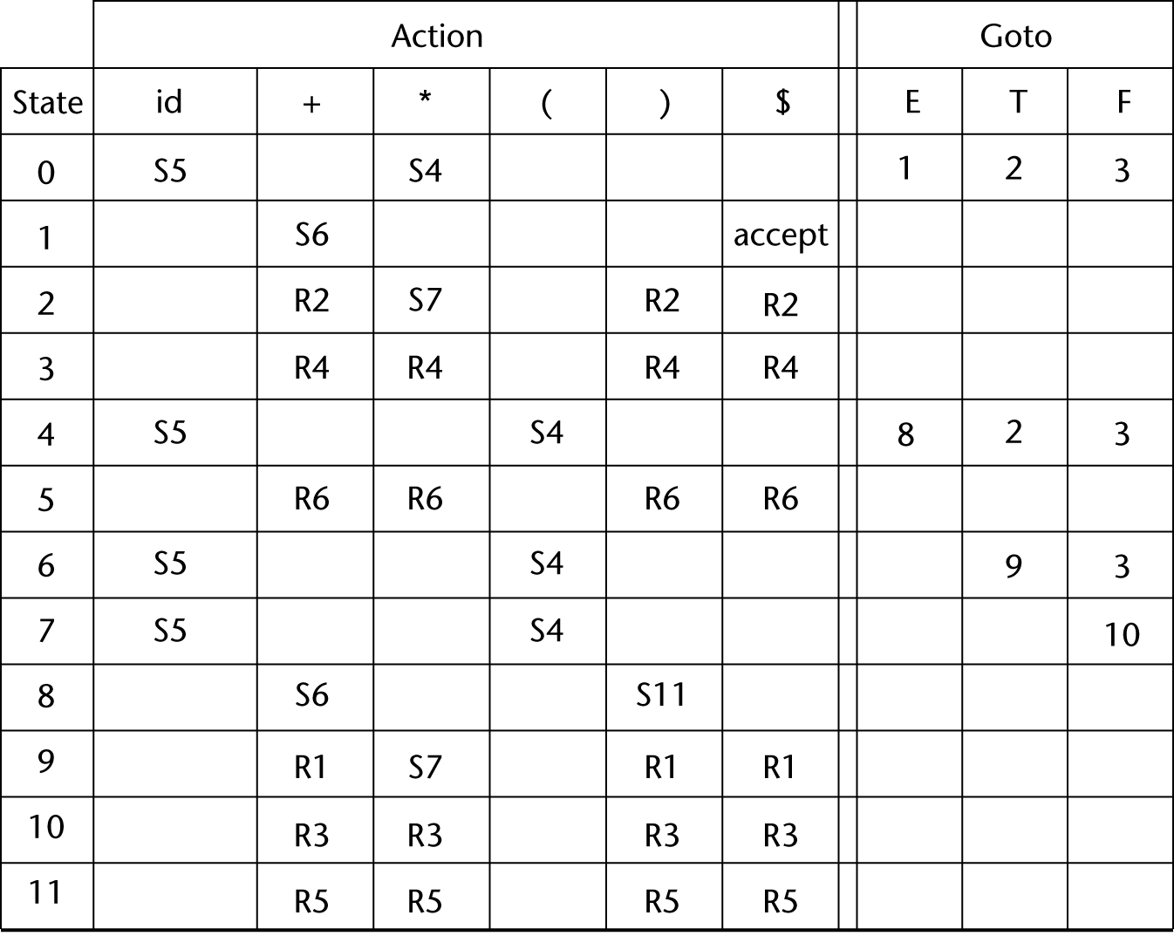
LR Parsing Table
S4

Slide 164
Bottom-up Parsing (cont.)
Grammar (1) rewritten and numbered for easy referencing in a parsing table.
E → E + T
E → T
T → T * F
T → F
F → ( E )
F → id

Slide 165
Bottom-up Parsing (cont.)
Stack | Input | Action
0 | id + id * id $ | Shift 5
0id5 | + id * id $ | Reduce 6 (use GOTO[0, F])
0F3 | + id * id $ | Reduce 4 (use GOTO[0, T])
0T2 | + id * id $ | Reduce 2 (use GOTO[0, E])
0E1 | + id * id $ | Shift 6
0E1+6 | id * id $ | Shift 5
0E1+6id5 | * id $ | Reduce 6 (use GOTO[6, F])
0E1+6F3 | * id $ | Reduce 4 (use GOTO[6, T])
0E1+6T9 | * id $ | Shift 7
0E1+6T9*7 | id $ | Shift 5
0E1+6T9*7id5 | $ | Reduce 6 (use GOTO[7, F])
0E1+6T9*7F10 | $ | Reduce 3 (use GOTO[6, T])
0E1+6T9 | $ | Reduce 1 (use GOTO[0, E])
0E1 | $ | Accept

Slide 166
Bottom-up Parsing (cont.)
A parser table can be generated from a given grammar with a tool, e.g., yacc

Slide 167
Summary
Syntax analysis is a common part of language implementation
A lexical analyzer is a pattern matcher that isolates small-scale parts of a program
Detects syntax errors
Produces a parse tree
A recursive-descent parser is an LL parser
EBNF
Parsing problem for bottom-up parsers: find the substring of current sentential form
The LR family of shift-reduce parsers is the most common bottom-up parsing approach

Slide 168
Chapter 4
Names, Bindings, Type Checking, and Scopes

Slide 169
Chapter 5 Topics
Introduction
Names
Variables
The Concept of Binding
Scope
Scope and Lifetime
Referencing Environments
Named Constants

Slide 170
Introduction
Imperative languages are abstractions of von Neumann architecture where two primary components are
Memory
Processor
Variables characterized by attributes
Type: to design, must consider scope, lifetime, type checking, initialization, and type compatibility

Slide 171
Names
Name : string of characters used to identify some entity in a program
Common form of names : a letter followed by a string (letters, digits and underscore)
Some languages (i.e. Fortran90) allow embedded space in names.

Slide 172
Names
Design issues
The form of names
Maximum length?
Are connector characters allowed?
Are names case sensitive?
Are special words reserved words or keywords?

Slide 173
Names (continued)
Length
If too short, they cannot be connotative
Language examples:
FORTRAN I: maximum 6
COBOL: maximum 30
FORTRAN 90 and ANSI C: maximum 31
Ada and Java: no limit, and all are significant
C++: no limit, but implementers often impose one

Slide 174
Names (continued)
Connectors
Pascal, Modula-2, and FORTRAN 77 don't allow
Others do
Popular in 70s and 80s, replaced by so-called “camel” notation
Using connectors : Sum_Of_Salaries
“camel” notation : SumOfSalaries

Slide 175
Names (continued)
Case sensitivity
Disadvantage: readability (names that look alike are different)
Can be avoided using naming conventions
worse in C++ and Java because predefined names are mixed case (e.g. IndexOutOfBoundsException)
C, C++, and Java names are case sensitive
The names in other languages are not
Difficult to remember the case usage – resulting in difficulties in writing a program

Slide 176
Names (continued)
Special words
An aid to readability; used to delimit or separate statement clauses
A keyword is a word that is special only in certain contexts, e.g., in Fortran
Real VarName (Real is a data type followed with a name, therefore Real is a keyword)
Real = 3.4 (Real is a variable)
A reserved word is a special word that cannot be used as a user-defined name

Slide 177
Variables
A variable is an abstraction of a memory cell
Variables can be characterized as a sextuple of attributes:
Name
Address
Value
Type
Lifetime
Scope

Slide 178
Variables Attributes
Name - most variables have them
Address - the memory address with which it is associated
A variable may have different addresses at different times during execution
A variable may have different addresses at different places in a program
If two variable names can be used to access the same memory location, they are called aliases
Aliases are created via pointers, reference variables, C and C++ unions
Aliases are harmful to readability (program readers must remember all of them)
Sometimes referred as l-value

Slide 179
Variables Attributes (continued)
Type - determines the range of values of variables and the set of operations that are defined for values of that type; in the case of floating point, type also determines the precision
Value - the contents of the location with which the variable is associated. Sometimes referred as r-value
Abstract memory cell - the physical cell or collection of cells associated with a variable

Slide 180
The Concept of Binding
The l-value of a variable is its address
The r-value of a variable is its value
A binding is an association, such as between an attribute and an entity, or between an operation and a symbol
Binding time is the time at which a binding takes place.

Slide 181
Possible Binding Times
Language design time -- bind operator symbols to operations
For example, the asterisk symbol (*) is usually bound to the multiplication operation at language design time.
Language implementation time-- bind floating point type to a representation
A data type, such as int in C, is bound to a range of possible values at language implementation time.
Compile time -- bind a variable to a type in C or Java
A variable in C (e.g. X) is bound to a particular data type (e.g. int)
Load time -- bind a FORTRAN 77 variable to a memory cell (or a C static variable)
A variable may be bound to a storage cell when the program is loaded into memory.
Runtime -- bind a nonstatic local variable to a memory cell.
That same binding does not happen until run time in some cases, as with variables declared in Java methods

Slide 182
Binding Times
Consider the following statement:
count = count + 5;
The type of count – bound at compile time
The set of possible values of count – bound at compiler design time
The meaning of + operator symbol – bound at compile time
The internal representation of the literal 5 – bound at compiler design time
The value of count – bound at execution time

Slide 183
Binding of Attributes to Variables
A binding is static if it first occurs before run time and remains unchanged throughout program execution.
A binding is dynamic if it first occurs during execution or can change during execution of the program

Slide 184
Type Binding
Variable must be bound to data type before it can be referenced in a program.
How is a type specified?
When does the binding take place?

Slide 185
Static Type Binding
If static, the type may be specified by either an explicit or an implicit declaration
An explicit declaration is a statement in a program that lists variable names and their respective types. E.g. int var;
An implicit declaration is a default mechanism for specifying types of variables (the first appearance of the variable in the program). E.g. in FORTRAN, identifier beginning with I, J, K, L, M or N are implicitly declared at integer type. Otherwise real type.
Advantage: writability
Disadvantage: reliability

Slide 186
Dynamic Type Binding
Dynamic Type Binding (JavaScript and PHP)
Specified through an assignment statement.
New assignment override the previous assignment
e.g., JavaScript
list = [2, 4.33, 6, 8];
list = 17.3;
Advantage: flexibility (generic program units)
Disadvantages:
High cost (dynamic type checking and interpretation)
Type error detection by the compiler is difficult

Slide 187
Type inference
The type of most expressions can be determined without requiring the programmer to specify the types of the variables.
E.g. (ML programming language):
fun circumf(r) = 3.14159*r*r;
The type floating point (real in ML) is inferred for variable r.

Slide 188
Storage Bindings & Lifetime
Two important processes in binding
Allocation - getting a memory cell from some pool of available memory
Deallocation - putting a cell back into the pool
The lifetime of a variable is the time during which it is bound to a particular memory cell

Slide 189
Storage Bindings & Lifetime
Static
Bound to memory cells before execution begins and remains bound to the same memory cell throughout execution,
e.g. C static variables.
Advantages: efficiency (direct addressing), history-sensitive subprogram support
Disadvantage: lack of flexibility (no recursive subprogram) and storage cannot be shared with other variables

Slide 190
Storage Bindings & Lifetime
Stack-dynamic
Stack dynamic variables are allocated from the run-time stack.
Storage bindings are created for variables when their declaration statements are elaborated.
E.g. local variables in C subprograms and Java methods
All attributes except storage are statically bound
Advantage: allows recursion; conserves storage
Disadvantages:
Overhead of allocation and deallocation
Subprograms cannot be history sensitive
Inefficient references (indirect addressing)

Slide 191
Storage Bindings & Lifetime
Explicit heap-dynamic
Nameless memory cells that are allocated and deallocated by explicit run-time instructions specified by the programmer, which take effect during execution, e.g.
int *intnode;
intnode = new int;
….
delete intnode;
Referenced only through pointers or references, e.g. dynamic objects in C++ (via new and delete), all objects in Java
Advantage: provides for dynamic storage management that can grow and shrink.
Disadvantage: difficulty of using pointers and the complexity of storage management.

Slide 192
Storage Bindings & Lifetime
Implicit heap-dynamic
Bound to heap storage only when they are assigned values (dynamic type binding).
all variables in APL; all strings and arrays in Perl and JavaScript i.e. dynamic type binding variables
E.g.
height = [74, 84, 86, 90, 71]
Advantage:
Highest degree of flexibility
Disadvantages:
Run-time overhead in maintaining the the dynamic attributes
Loss of error detection

Slide 193
Scope
The scope of a variable is the range of statements over which it is visible (a variable is visible if it can be referenced in that statement)
The scope rules of a language determine how references to names are associated with variables
The nonlocal variables of a program unit are those that are visible but not declared there

Slide 194
Static Scope
Based on program text
To connect a name reference to a variable, you (or the compiler) must find the declaration
Search process: search declarations, first locally, then in increasingly larger enclosing scopes, until one is found for the given name
Enclosing static scopes (to a specific scope) are called its static ancestors; the nearest static ancestor is called a static parent

Slide 195
Static Scope (continued)
Variables can be hidden from a unit by having a "closer" variable with the same name
E.g.
procedure Big is
X : Integer;
procedure Sub1 is
x : Integer;
begin
…
end;
procedure Sub2 is
begin
… X …
end;
begin
…
end;
C++ and Ada allow access to these hidden variables.
In Ada: unit.name
In C++: class_name::name

Slide 196
Blocks
A method of creating static scopes inside program units e.g. compound statements
E.g.
C and C++:
if (list[i] < list[j]){
int temp;
temp = list[i];
list[i] = list[j];
list[j] = temp;
}
#include <stdio.h>
int main() {
int n = 1; A
{ A
int n = 2; B
printf("%d\n", n); B
} B
printf("%d\n", n); A
} A

Slide 197
Blocks (continued)
The scopes created by blocks are treated exactly like those created by subprograms.
Referenced to variables in a block that are not declared there are connected to declarations by searching enclosing scopes in order of increasing size.
Another e.g.
void sub(){
int count;
…
while(…){
int count;
count++;
}
…
}
This code is valid in C and C++ but not in Java and C#

Slide 198
Global Scope
Declared outside any function definitions and accessible throughout the program.
In C, a local variable can be made global with the use of the reserved work extern

Slide 199
Dynamic Scope
Based on calling sequences of program units, not their textual layout (temporal versus spatial)
The scope can be determined only at run time.
References to variables are connected to declarations by searching back through the chain of subprogram calls that forced execution to this point

Slide 200
Dynamic Scope
Consider the following two different call sequences for Sub2 in the previous procedure Big example.
Big calls Sub1, which calls Sub2. X therefore refers to the X declared in Sub1.
Sub2 is called directly from Big. X therefore refers to the X declared in Big.
function big() {
function sub1() {
var x = 7;
}
function sub2() {
var y = x;
var z = 3;
}
var x = 3;
}

Slide 201
Scope
Evaluation of Dynamic Scoping:
Advantage: convenience
Disadvantage:
Can’t protect local variables from accessibility
Inability to statically type check references to nonlocals
poor readability – virtually impossible for human reader
Longer time to access nonlocal variables compared to static scoping

Slide 202
Scope and Lifetime
Scope and lifetime are sometimes closely related, but are different concepts
E.g.
void printheader(){
…
}
void compute(){
int sum;
…
printheader();
}
Consider also a static variable in a C or C++ function. It is statically bound to the scope of that function. But the lifetime is throughout program execution.

Slide 203
Referencing Environments
The referencing environment of a statement is the collection of all names that are visible in the statement, excluding variables in nonlocal scopes that are hidden by declarations in nearer procedures.
In a static-scoped language, it is the local variables plus all of the visible variables in all of the enclosing scopes

Slide 204
Referencing Environments
procedure Example is
A, B : Integer;
…
procedure Sub1 is
X, Y : Integer;
begin
… <------------- 1
end;
procedure Sub2 is
X : Integer;
…
procedure Sub3 is
X : Integer;
begin
… <----------- 2
end;
begin
… <-------------- 3
end;
begin
…
end;
At point 1: X and Y of Sub1, A and B of Example
At point 2: X of Sub3, (X of Sub2 is hidden), A and B of Example
At point 3: X of Sub2, A and B of Example

Slide 205
Referencing Environments
A subprogram is active if its execution has begun but has not yet terminated
Therefore, in a dynamic-scoped language, the referencing environment is the local variables plus all visible variables in all active subprograms

Slide 206
Referencing Environments
void sub1(){
int a, b;
… <---------------1
}
void sub2(){
int b, c;
… <--------------2
sub1;
}
void main(){
int c, d;
… <--------------3
sub2();
}
What are the referencing environments at points 1, 2 and 3?
At point 1: a and b of Sub1, c of Sub2, d of main
At point 2: b and c of Sub2, d of main
At point 3: c and d of main

Slide 207
Named Constants
A named constant is a variable that is bound to a value only once e.g. const float pi = 3.142
Used to parameterize programs, e.g.
void example(){
int[] intlist = new int[100];
string[] strList = new String[100];
…
for(index=0; index<100; index++) {
…
}
…
}

Slide 208
Named Constants
Replacing 100 with a constant len
void example(){
final int len = 100
int[] intlist = new int[len];
string[] strList = new String[len];
…
for(index=0; index<len; index++) {
…
}
…
}
Advantages: readability and program reliability

Slide 209
Summary
Case sensitivity and the relationship of names to special words represent design issues of names
Variables are characterized by the sextuples: name, address, value, type, lifetime, scope
Binding is the association of attributes with program entities
Scalar variables are categorized as: static, stack dynamic, explicit heap dynamic, implicit heap dynamic (for storage binding)

Slide 210
Chapter 5
Data Types

Slide 211
Chapter 6 Topics
Introduction
Primitive Data Types
Character String Types
User-Defined Ordinal Types
Array Types
Associative Arrays
Record Types
Union Types
Pointer and Reference Types

Slide 212
Introduction
A data type defines a collection of data objects and a set of predefined operations on those objects
A descriptor is the collection of the attributes of a variable
An object represents an instance of a user-defined (abstract data) type
One design issue for all data types: What operations are defined and how are they specified?

Slide 213
Primitive Data Types
Almost all programming languages provide a set of primitive data types
Primitive data types: Those not defined in terms of other data types
Some primitive data types are merely reflections of the hardware
Others require little non-hardware support

Slide 214
Primitive Data Types: Integer
Almost always an exact reflection of the hardware so the mapping is trivial
There may be as many as eight different integer types in a language
Java’s signed integer sizes: byte, short, int, long

Slide 215
Primitive Data Types: Floating Point
Model real numbers, but only as approximations
Languages for scientific use support at least two floating-point types (e.g., float and double; sometimes more
Usually exactly like the hardware, but not always
IEEE Floating-Point
Standard 754

Slide 216
Primitive Data Types: Decimal
For business applications (money)
Essential to COBOL
C# offers a decimal data type
Store a fixed number of decimal digits
Advantage: accuracy
Disadvantages: limited range, wastes memory

Slide 217
Primitive Data Types: Boolean
Simplest of all
Range of values: two elements, one for “true” and one for “false”
Could be implemented as bits, but often as bytes
Advantage: readability

Slide 218
Primitive Data Types: Character
Stored as numeric codings
Most commonly used coding: ASCII
An alternative, 16-bit coding: Unicode
Includes characters from most natural languages
Originally used in Java
C# and JavaScript also support Unicode

Slide 219
Character String Types
Values are sequences of characters
Design issues:
Is it a primitive type or just a special kind of array?
Should the length of strings be static or dynamic?

Slide 220
Character String Types Operations
Typical operations:
Assignment and copying
Comparison (=, >, etc.)
Catenation
Substring reference
Pattern matching

Slide 221
Character String Type in Certain Languages
C and C++
Not primitive
Use char arrays and a library of functions that provide operations
SNOBOL4 (a string manipulation language)
Primitive
Many operations, including elaborate pattern matching
Java
Primitive via the String class

Slide 222
Character String Length Options
Static: COBOL, Java’s String class
Limited Dynamic Length: C and C++
In C-based language, a special character is used to indicate the end of a string’s characters, rather than maintaining the length
Dynamic (no maximum): SNOBOL4, Perl, JavaScript
Ada supports all three string length options

Slide 223
Character String Type Evaluation
Aid to writability
As a primitive type with static length, they are inexpensive to provide--why not have them?
Dynamic length is nice, but is it worth the expense?

Slide 224
Character String Implementation
Static length: compile-time descriptor
Limited dynamic length: may need a run-time descriptor for length (but not in C and C++)
Dynamic length: need run-time descriptor; allocation/de-allocation is the biggest implementation problem

Slide 225
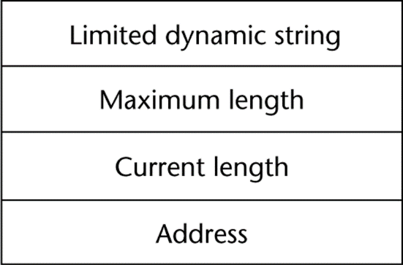
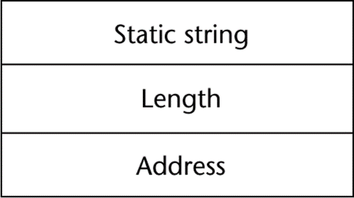
Compile- and Run-Time Descriptors
Compile-time descriptor for static strings
Run-time descriptor for limited dynamic strings

Slide 226
User-Defined Ordinal Types
An ordinal type is one in which the range of possible values can be easily associated with the set of positive integers
Examples of primitive ordinal types in Java
integer
char
boolean

Slide 227
Enumeration Types
All possible values, which are named constants, are provided in the definition
C# example
enum days {mon, tue, wed, thu, fri, sat, sun};
Design issues
Is an enumeration constant allowed to appear in more than one type definition, and if so, how is the type of an occurrence of that constant checked?
Are enumeration values coerced to integer?
Any other type coerced to an enumeration type?

Slide 228
Evaluation of Enumerated Type
Aid to readability, e.g., no need to code a color as a number
Aid to reliability, e.g., compiler can check:
operations (don’t allow colors to be added)
No enumeration variable can be assigned a value outside its defined range
Ada, C#, and Java 5.0 provide better support for enumeration than C++ because enumeration type variables in these languages are not coerced into integer types

Slide 229
Subrange Types
An ordered contiguous subsequence of an ordinal type
Example: 12..18 is a subrange of integer type
Ada’s design
type Days is (mon, tue, wed, thu, fri, sat, sun);
subtype Weekdays is Days range mon..fri;
subtype Index is Integer range 1..100;
Day1: Days;
Day2: Weekday;
Day2 := Day1;

Slide 230
Subrange Evaluation
Aid to readability
Make it clear to the readers that variables of subrange can store only certain range of values
Reliability
Assigning a value to a subrange variable that is outside the specified range is detected as an error

Slide 231
Implementation of User-Defined Ordinal Types
Enumeration types are implemented as integers
Subrange types are implemented like the parent types with code inserted (by the compiler) to restrict assignments to subrange variables

Slide 232
Array Types
An array is an aggregate of homogeneous data elements in which an individual element is identified by its position in the aggregate, relative to the first element.

Slide 233
Array Design Issues
What types are legal for subscripts?
Are subscripting expressions in element references range checked?
When are subscript ranges bound?
When does allocation take place?
What is the maximum number of subscripts?
Can array objects be initialized?
Are any kind of slices allowed?

Slide 234
Array Indexing
Indexing (or subscripting) is a mapping from indices to elements
array_name (index_value_list) → an element
Array reference : array name followed by list of subscripts which surrounded by brackets or parentheses.
Index Syntax
FORTRAN, PL/I, Ada use parentheses
Ada explicitly uses parentheses to show uniformity between array references and function calls because both are mappings
Most other languages use brackets

Slide 235
Arrays Index (Subscript) Types
FORTRAN, C: integer only
Pascal: any ordinal type (integer, Boolean, char, enumeration)
Ada: integer or enumeration (includes Boolean and char)
Java: integer types only
C, C++, Perl, and Fortran do not specify range checking
Java, ML, C# specify range checking

Slide 236
Subscript Binding and Array Categories
Static: subscript ranges are statically bound and storage allocation is static (before run-time)
Advantage: efficiency (no dynamic allocation)
Fixed stack-dynamic: subscript ranges are statically bound, but the allocation is done at declaration time
Advantage: space efficiency

Slide 237
Subscript Binding and Array Categories (continued)
Stack-dynamic: subscript ranges are dynamically bound and the storage allocation is dynamic (done at run-time)
Advantage: flexibility (the size of an array need not be known until the array is to be used)
Fixed heap-dynamic: similar to fixed stack-dynamic: storage binding is dynamic but fixed after allocation (i.e., binding is done when requested and storage is allocated from heap, not stack)

Slide 238
Subscript Binding and Array Categories (continued)
Heap-dynamic: binding of subscript ranges and storage allocation is dynamic and can change any number of times
Advantage: flexibility (arrays can grow or shrink during program execution)

Slide 239
Subscript Binding and Array Categories (continued)
C and C++ arrays that include static modifier are static
C and C++ arrays without static modifier are fixed stack-dynamic
Ada arrays can be stack-dynamic
C and C++ provide fixed heap-dynamic arrays
C# includes a second array class ArrayList that provides fixed heap-dynamic
Perl and JavaScript support heap-dynamic arrays

Slide 240
Array Initialization
Some language allow initialization at the time of storage allocation
C, C++, Java, C# example
int list [] = {4, 5, 7, 83}
Character strings in C and C++
char name [] = “freddie”;
Arrays of strings in C and C++
char *names [] = {“Bob”, “Jake”, “Joe”];
Java initialization of String objects
String[] names = {“Bob”, “Jake”, “Joe”};

Slide 241
Arrays Operations
APL provides the most powerful array processing operations for vectors and matrices as well as unary operators (for example, to reverse column elements)
Ada allows array assignment but also catenation
Fortran provides elemental operations because they are between pairs of array elements
For example, + operator between two arrays results in an array of the sums of the element pairs of the two arrays

Slide 242
Rectangular and Jagged Arrays
A rectangular array is a multi-dimensioned array in which all of the rows have the same number of elements and all columns have the same number of elements
A jagged matrix has rows with varying number of elements
Possible when multi-dimensioned arrays actually appear as arrays of arrays

Slide 243
Slices
A slice is some substructure of an array; nothing more than a referencing mechanism
Slices are only useful in languages that have array operations

Slide 244
Slice Examples
Fortran 95
Integer, Dimension (10) :: Vector
Integer, Dimension (3, 3) :: Mat
Integer, Dimension (3, 3) :: Cube
Vector (3:6) is a four element array

Slide 245
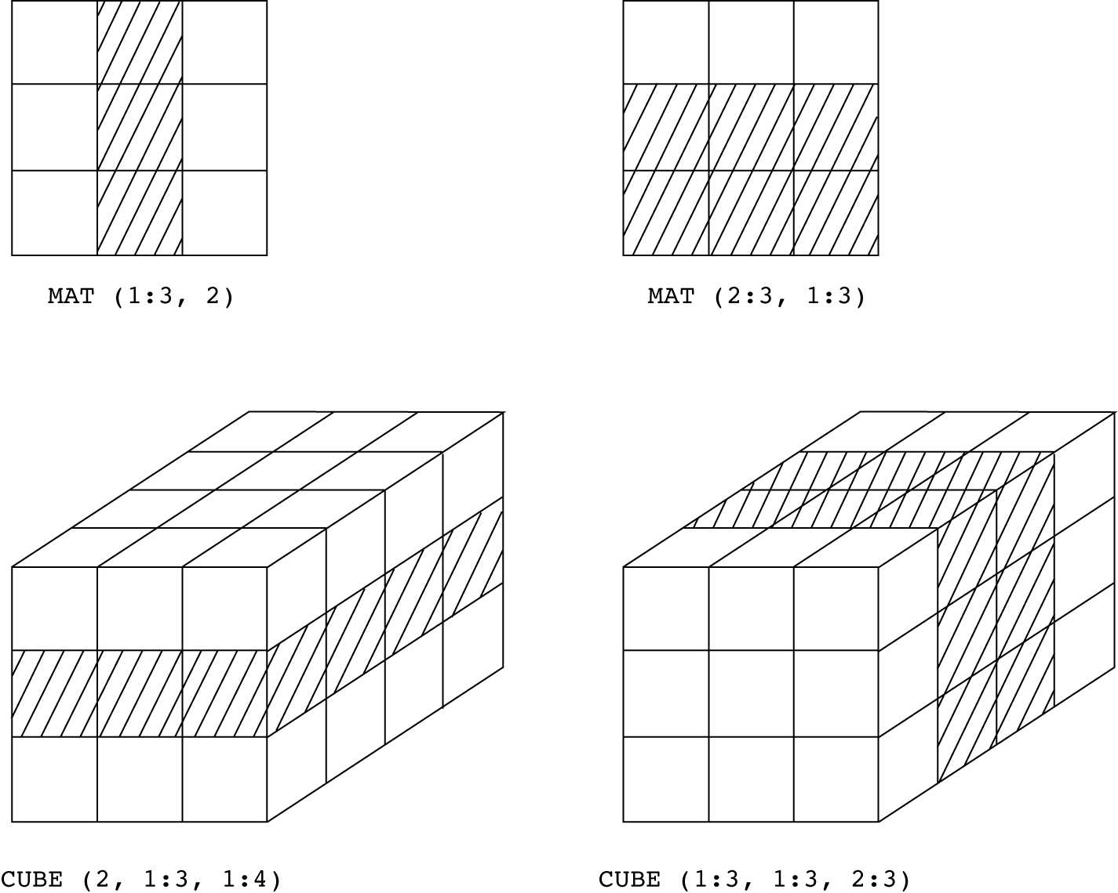
Slices Examples in Fortran 95

Slide 246
Implementation of Arrays
Access function maps subscript expressions to an address in the array
Access function for single-dimensioned arrays:
address(list[k]) = address (list[lower_bound])
+ k * element_size

Slide 247
Accessing Multi-dimensioned Arrays (SKIP TO POINTER)
Two common ways:
Row major order (by rows)
used in most languages
Elements of the array that have as their first subscript the lower bound value of that subscript are stored first followed by the elements of second of the first value, and so forth
column major order (by columns) – used in Fortran
The elements of an array that have as their last subscript the lower bound value of that subscript are stored first, followed by the elements of the second value of the last subscript, and so forth

Slide 248
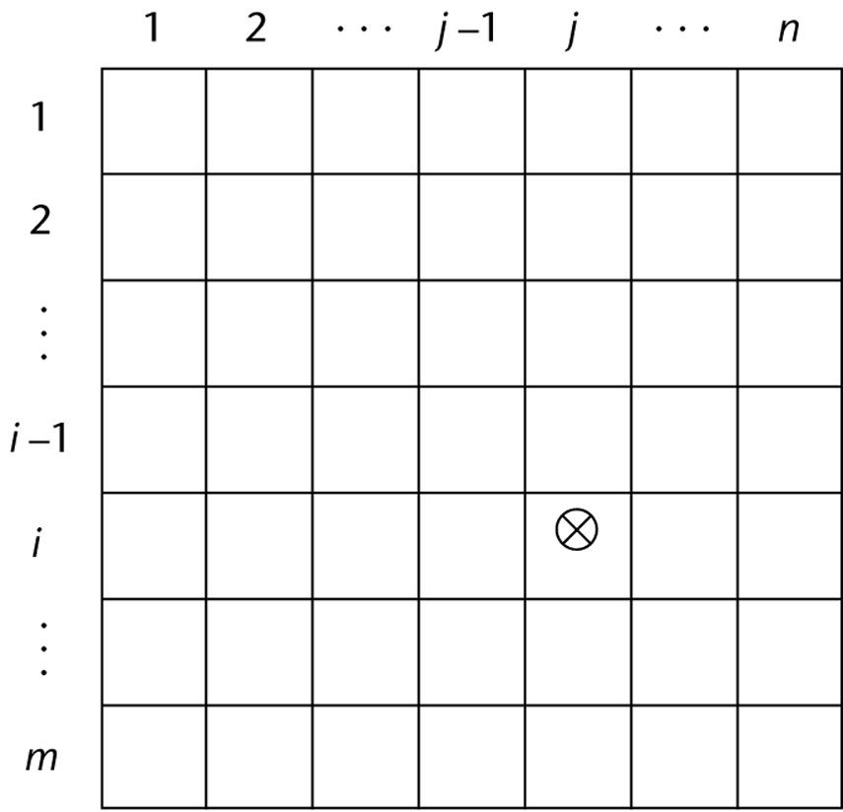
Locating an Element in a Multi-dimensioned Array
General format
location (a[i,j]) = address of a [row_lb,col_lb]
+ (((i - row_lb) * n) + (j - col_lb))
* element_size

Slide 249
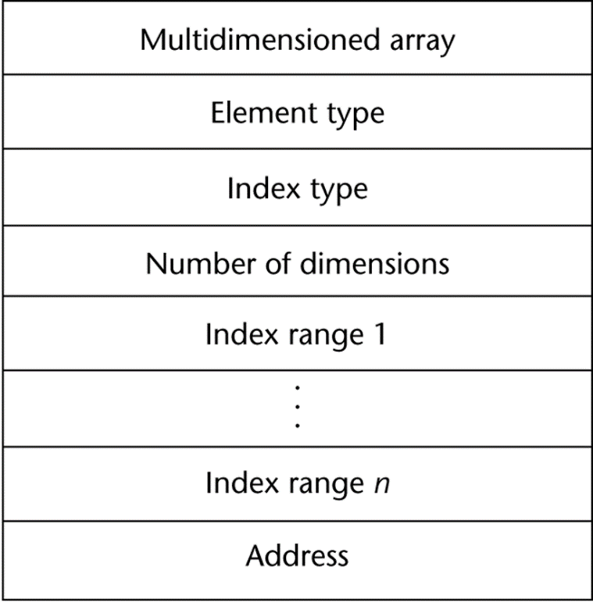
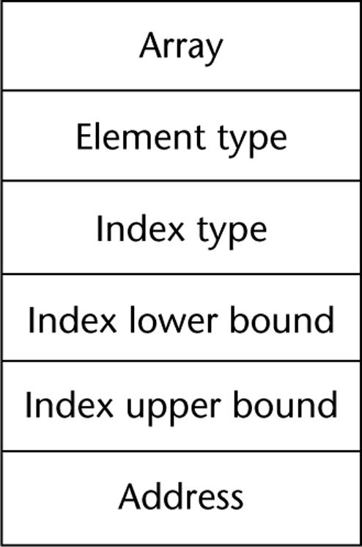
Compile-Time Descriptors
Single-dimensioned array
Multi-dimensional array

Slide 250
Associative Arrays
An associative array is an unordered collection of data elements that are indexed by an equal number of values called keys
Index never need to be stored
User defined keys must be stored
Each element of an associative array in fact is a pair of entities, a key and a value.
Design issues: What is the form of references to elements

Slide 251
Associative Arrays in Perl
Names begin with %; literals are delimited by parentheses
%hi_temps = ("Mon" => 77, "Tue" => 79, “Wed” => 65, …);
Subscripting is done using braces and keys
$hi_temps{"Wed"} = 83;
Elements can be removed with delete
delete $hi_temps{"Tue"};

Slide 252
Record Types
A record is a possibly heterogeneous aggregate of data elements in which the individual elements are identified by names
Design issues:
What is the syntactic form of references to the field?
Are elliptical references allowed

Slide 253
Definition of Records
COBOL uses level numbers to show nested records; others use recursive definition
Record Field References
1. COBOL
field_name OF record_name_1 OF ... OF record_name_n
2. Others (dot notation)
record_name_1.record_name_2. ... record_name_n.field_name

Slide 254
Definition of Records in COBOL
COBOL uses level numbers to show nested records; others use recursive definition
01 EMP-REC.
02 EMP-NAME.
05 FIRST PIC X(20).
05 MID PIC X(10).
05 LAST PIC X(20).
02 HOURLY-RATE PIC 99V99.

Slide 255
Definition of Records in Ada
Record structures are indicated in an orthogonal way
type Emp_Rec_Type is record
First: String (1..20);
Mid: String (1..10);
Last: String (1..20);
Hourly_Rate: Float;
end record;
Emp_Rec: Emp_Rec_Type;

Slide 256
References to Records
Most language use dot notation
Emp_Rec.Name
Fully qualified references must include all record names
Elliptical references allow leaving out record names as long as the reference is unambiguous, for example in COBOL
FIRST, FIRST OF EMP-NAME, and FIRST of EMP-REC are elliptical references to the employee’s first name

Slide 257
Operations on Records
Assignment is very common if the types are identical
Ada allows record comparison
Ada records can be initialized with aggregate literals
COBOL provides MOVE CORRESPONDING
Copies a field of the source record to the corresponding field in the target record

Slide 258
Evaluation and Comparison to Arrays
Straight forward and safe design
Records are used when collection of data values is heterogeneous
Access to array elements is much slower than access to record fields, because subscripts are dynamic (field names are static)
Dynamic subscripts could be used with record field access, but it would disallow type checking and it would be much slower

Slide 259
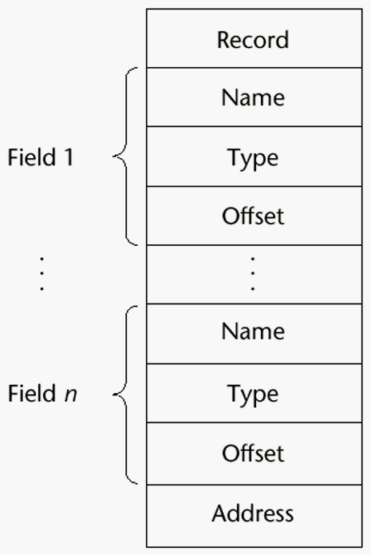
Implementation of Record Type
Offset address relative to the beginning of the records is associated with each field

Slide 260
Unions Types
A union is a type whose variables are allowed to store different type values at different times during execution
Design issues
Should type checking be required?
Should unions be embedded in records?

Slide 261
Free Union
Fortran, C, and C++ provide union constructs in which there is no language support for type checking; the union in these languages is called free union
union flexType{
int intEl;
float floatEl;
};

Slide 262
Discriminated Union
Type checking of unions require that each union include a type indicator called a discriminant, hence called discriminated union.
Supported by Ada
type Shape is (Circle, Triangle, Rectangle);
type Colors is (Red, Green, Blue);
type Figure (Form: Shape) is record
Filled: Boolean;
Color: Colors;
case Form is
when Circle => Diameter: Float;
when Triangle =>
Leftside, Rightside: Integer;
Angle: Float;
when Rectangle => Side1, Side2: Integer;
end case;
end record;

Slide 263
Discriminated Union
Figure_1 : Figure;
Figure_2 : Figure(Form => Triangle);
Figure_1 := (Filled => True,
Color => Blue,
Form => Rectangle,
Side_1 => 12,
Side_2 => 3);
Statement
if (Figure_1.Diameter > 3.0) …
gives syntax error.

Slide 264
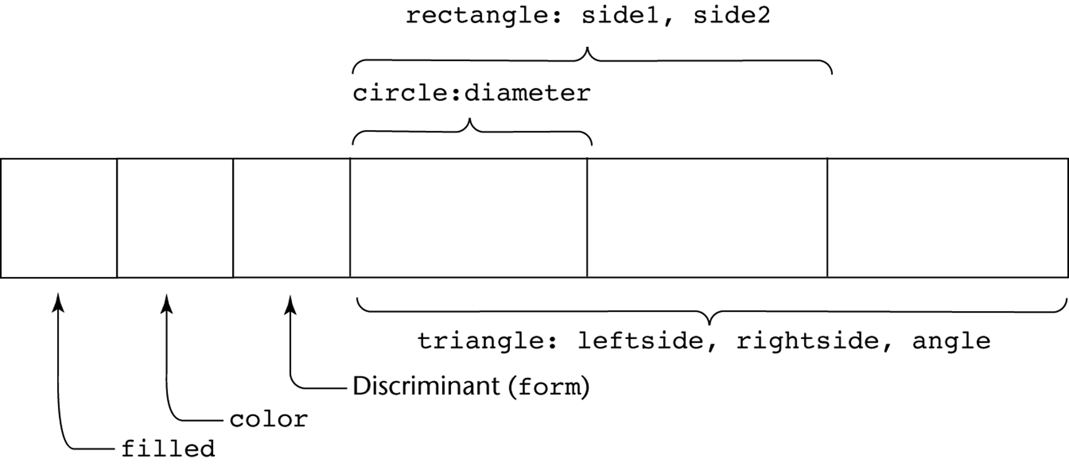
Ada Union Type Illustrated
A discriminated union of three shape variables

Slide 265
Evaluation of Unions
Potentially unsafe construct
Do not allow type checking
Java and C# do not support unions
Reflective of growing concerns for safety in programming language

Slide 266
Pointer and Reference Types
A pointer type variable has a range of values that consists of memory addresses and a special value, nil
Advantages of pointers:
Provide the power of indirect addressing
Provide a way to manage dynamic memory
A pointer can be used to access a location in the area where storage is dynamically created (usually called a heap)

Slide 267
Design Issues of Pointers
What are the scope of and lifetime of a pointer variable?
What is the lifetime of a heap-dynamic variable?
Are pointers restricted as to the type of value to which they can point?
Are pointers used for dynamic storage management, indirect addressing, or both?
Should the language support pointer types, reference types, or both?

Slide 268
Pointer Operations
Two fundamental operations: assignment and dereferencing
Assignment is used to set a pointer variable’s value to some useful address
Dereferencing yields the value stored at the location represented by the pointer’s value
Dereferencing can be explicit or implicit
C++ uses an explicit operation via *
j = *ptr
sets j to the value located at ptr

Slide 269
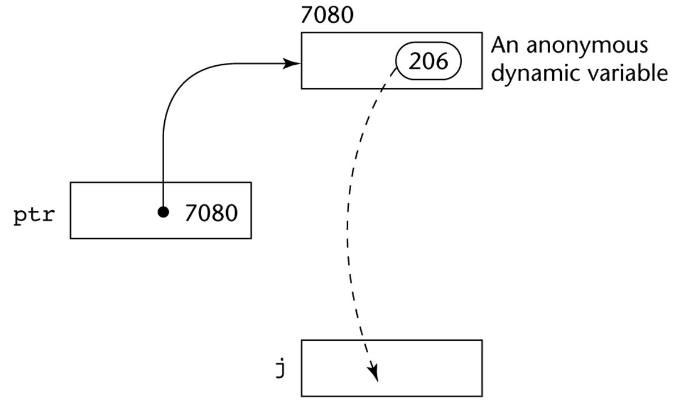
Pointer Assignment Illustrated
The assignment operation j = *ptr

Slide 270
Problems with Pointers
Dangling pointers (dangerous)
A pointer points to a heap-dynamic variable that has been de-allocated
Dangerous for several reasons because location being pointed to may have been reallocated to some new heap-dynamic variable.
Example:
int *arrayPtr1;
int *arrayPtr2 = new int[100];
arrayPtr1 = arrayPtr2;
delete [] arrayPtr2;

Slide 271
Problems with Pointers
Lost heap-dynamic variable
An allocated heap-dynamic variable that is no longer accessible to the user program (often called garbage or memory leakage)
Pointer p1 is set to point to a newly created heap-dynamic variable
Pointer p1 is later set to point to another newly created heap-dynamic variable

Slide 272
Pointers in Ada
Some dangling pointers are disallowed because dynamic objects can be automatically de-allocated at the end of pointer's type scope
The lost heap-dynamic variable problem is not eliminated by Ada

Slide 273
Pointers in C and C++
Extremely flexible but must be used with care
Pointers can point at any variable regardless of when it was allocated
Used for dynamic storage management and addressing
Pointer arithmetic is possible
Explicit dereferencing and address-of operators
Domain type need not be fixed (void *)
void * can point to any type and can be type checked (cannot be de-referenced)

Slide 274
Pointer Arithmetic in C and C++
float stuff[100];
float *p;
p = stuff; // assign address of stuff[0] to p
*(p+5) is equivalent to stuff[5] and p[5]
*(p+i) is equivalent to stuff[i] and p[i]

Slide 275
Reference Types
Similar to pointer except that it is referring to an object or a value in memory rather than an address.
C++ includes a special kind of pointer type called a reference type that is used primarily for formal parameters
Advantages of both pass-by-reference and pass-by-value
Java extends C++’s reference variables and allows them to replace pointers entirely
References refer to call instances
C# includes both the references of Java and the pointers of C++

Slide 276
Evaluation of Pointers
Dangling pointers and dangling objects are problems as is heap management
Pointers are like goto's--they widen the range of cells that can be accessed by a variable
Pointers or references are necessary for dynamic data structures--so we can't design a language without them

Slide 277
Representations of Pointers (SKIP TO TYPE CHECKING)
Large computers use single values stored in memory cells.
Intel microprocessors, addresses have tow parts: segment and offset. 16 bit cell needed for each.

Slide 278
Solution to Dangling Pointer Problem
Tombstone: extra heap cell that is a pointer to the heap-dynamic variable
The actual pointer variable points only at tombstones
When heap-dynamic variable de-allocated, tombstone remains but set to nil
Costly in time and space (tombstone never deallocated)
. Locks-and-keys: Pointer values are represented as (key, address) pairs
Heap-dynamic variables are represented as variable plus cell for integer lock value
When heap-dynamic variable allocated, lock value is created and placed in lock cell and key cell of pointer

Slide 279
Heap Management
A very complex run-time process
Single-size cells vs. variable-size cells
For single-size cells, there are two approaches to reclaim garbage
Reference counters (eager approach): reclamation is gradual
Garbage collection/mark-sweep (lazy approach): reclamation occurs when the list of variable space becomes empty

Slide 280
Reference Counter
Reference counters: maintain a counter in every cell that store the number of pointers currently pointing at the cell
Advantage: it is intrinsically incremental, i.e. actions are interleaved with those of applications. Therefore execution time is insignificant.
Disadvantages: space required, execution time required, complications for cells connected circularly

Slide 281
Garbage Collection
The run-time system allocates storage cells as requested and disconnects pointers from cells as necessary; garbage collection then begins
Every heap cell has an extra bit used by collection algorithm
Three distinct steps:
All cells initially set to garbage
All pointers traced into heap, and reachable cells marked as not garbage (mark)
All garbage cells returned to list of available cells (sweep)
Disadvantages: when you need it most, it works worst (takes most time when program needs most of cells in heap)

Slide 282
Marking Algorithm
for every pointer r do
mark(r)
void mark(void *ptr){
if (ptr != 0)
if (*ptr.marker is not marked){
set *ptr.marker
mark(*ptr.llink)
mark(*ptr.rlink)
}
}

Slide 283
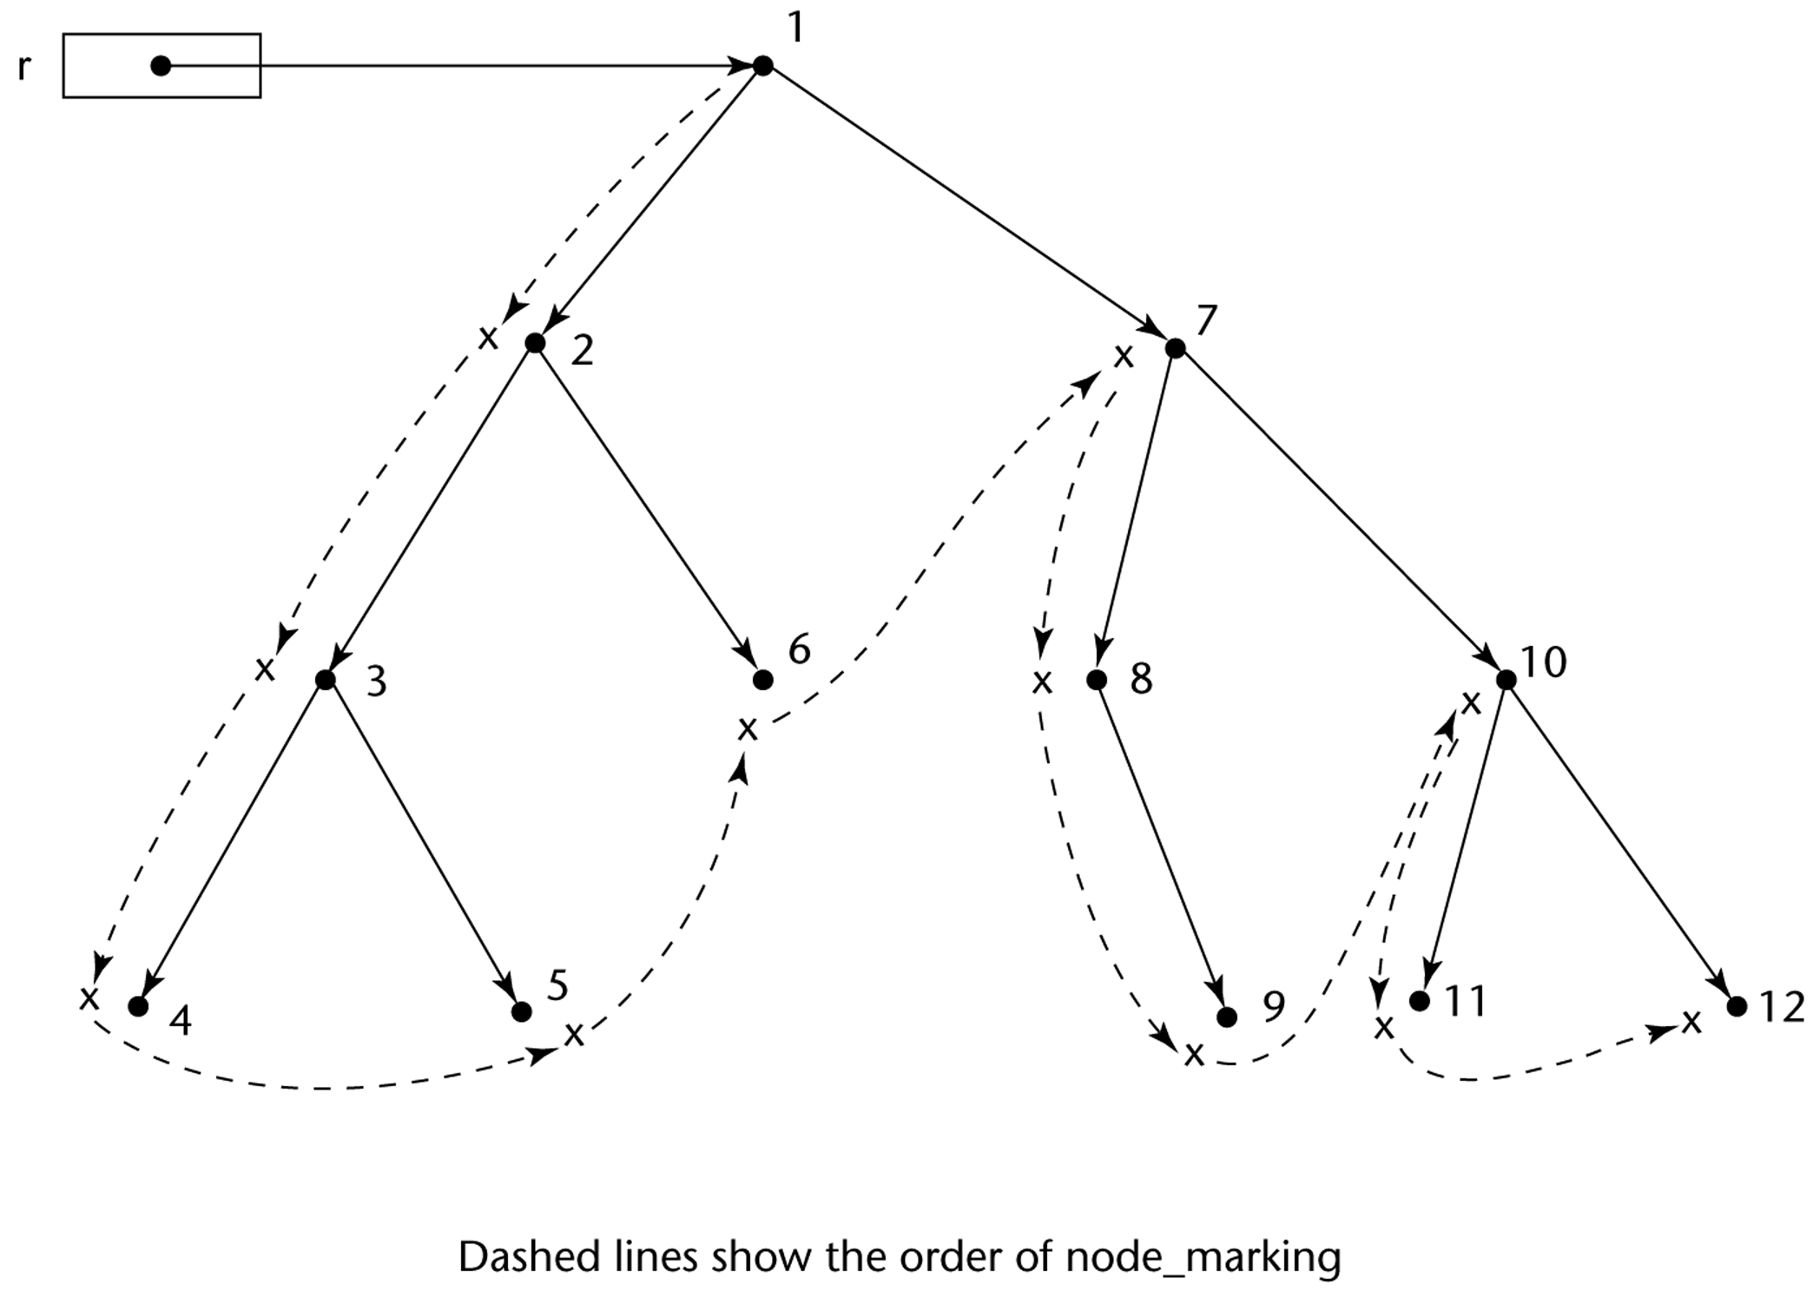
Marking Algorithm

Slide 284
Variable-Size Cells
All the difficulties of single-size cells plus more
Required by most programming languages
If garbage collection is used, additional problems occur
The initial setting of the indicators of all cells in the heap is difficult. Need to store cell size in one of its fields.
The marking process in nontrivial
Maintaining the list of available space is another source of overhead

Slide 285
Type Checking
Generalize the concept of operands and operators to include subprograms and assignments
Subprogram as operator, parameters as operands
Assignment symbol as binary operator, target variable and expression as operands
Type checking is the activity of ensuring that the operands of an operator are of compatible types
A compatible type is one that is either legal for the operator, or is allowed under language rules to be implicitly converted, by compiler- generated code, to a legal type
This automatic conversion is called a coercion. For example, adding an int to a float in Java causes int to be coerced to float

Slide 286
Type Checking (continued)
A type error is the application of an operator to an operand of an inappropriate type. For examples, in passing values to functions.
If all type bindings are static, nearly all type checking can be static
If type bindings are dynamic, type checking must be dynamic
A programming language is strongly typed if type errors are always detected

Slide 287
Strong Typing
Advantage of strong typing: allows the detection of the misuses of variables that result in type errors
Language examples:
FORTRAN 77 is not: parameters, EQUIVALENCE
Pascal is not: variant records
C and C++ are not: unions are not type checked
ML is strongly typed
Ada is, almost: type checking can be suspended with the calling of function Unchecked_Conversion. Java and C# are similar.

Slide 288
Strong Typing (continued)
Coercion rules strongly affect strong typing--they can weaken it considerably (C++ versus Ada)
Languages with a great deal of coercion, like Fortran, C, and C++ are les reliable than those with little coercion, such as Ada.
Although Java has just half the assignment coercions of C++, its strong typing is still far less effective than that of Ada

Slide 289
Type Equivalence
Type compatibility influences the design of the data types and the operation provided for values of those types.
Two different types of compatibility methods :
Name type equivalence
Structure type equivalence

Slide 290
Name Type Equivalence
Name type equivalence means the two variables have compatible types if they are in either the same declaration or in declarations that use the same type name
Easy to implement but more restrictive:
Subranges of integer types are not equivalence with integer types. In the following example, types of variable count and index are not equivalence.
type Indextype is 1..100;
count : Integer;
index : Indextype;
Formal parameters must be the same type as their corresponding actual parameters, especially user-defined types.

Slide 291
Structure Type Equivalence
Structure type equivalence means that two variables have compatible types if their types have identical structures
More flexible, but harder to implement because the entire structures of the two types must be checked for equivalence.

Slide 292
Structure Type Equivalence (continued)
Consider the problem of two structured types:
Are two record types equivalent if they are structurally the same but use different field names?
Are two array types equivalent if they are the same except that the subscripts are different?
(e.g. [1..10] and [0..9])
Are two enumeration types equivalent if their components are spelled differently?
With structural type equivalence, you cannot differentiate between types of the same structure (e.g. different units of speed, both float)

Slide 293
Summary
The data types of a language are a large part of what determines that language’s style and usefulness
The primitive data types of most imperative languages include numeric, character, and Boolean types
The user-defined enumeration and subrange types are convenient and add to the readability and reliability of programs
Arrays and records are included in most languages
Pointers are used for addressing flexibility and to control dynamic storage management

Slide 294
Chapter 6
Expressions and Assignment Statements

Slide 295
Chapter 7 Topics
Introduction
Arithmetic Expressions
Overloaded Operators
Type Conversions
Relational and Boolean Expressions
Short-Circuit Evaluation
Assignment Statements
Mixed-Mode Assignment

Slide 296
Introduction
Expressions are the fundamental means of specifying computations in a programming language
To understand expression evaluation, need to be familiar with the orders of operator and operand evaluation – which are dictated by the associativity and precedence rules
Essence of imperative languages is dominant role of assignment statements

Slide 297
Arithmetic Expressions
Arithmetic evaluation was one of the motivations for the development of the first programming languages
Arithmetic expressions consist of operators, operands, parentheses, and function calls
Most binary operators are infix i.e. operators appear between operands
Computation: fetching the operand & executing the arithmetic

Slide 298
Arithmetic Expressions: Design Issues
Design issues for arithmetic expressions
operator precedence rules
operator associativity rules
order of operand evaluation
operand evaluation side effects
operator overloading
mode mixing expressions

Slide 299
Arithmetic Expressions: Operators
A unary operator has one operand
y++
A binary operator has two operands
x +y
A ternary operator has three operands
y > 5 ? 1 : 0

Slide 300
Arithmetic Expressions: Operator Precedence Rules
The operator precedence rules for expression evaluation define the order in which “adjacent” operators of different precedence levels are evaluated
Typical precedence levels
 | Ruby | C-based | Ada
Highest | ** | Postfix ++, -- | **, bas
 | Unary +. - | Prefix ++, --, unary +, - | *, /, mod, rem
 | *, /, % | *, /, % | Unary +, -
Lowest | Binary +, - | Binary +, - | Binary +, -

Slide 301
Arithmetic Expressions: Operator Associativity Rule
The operator associativity rules for expression evaluation define the order in which adjacent operators with the same precedence level are evaluated
Typical associativity rules
Ruby – Left: *, /, +, -
Right: **
C-based – Left: Left: *, /, %, binary +, binary
Right ++, --, unary +, unary –
Ada – Left: all except **
Non-associative: **
APL is different; all operators have equal precedence and all operators associate right to left
Precedence and associativity rules can be overridden with parentheses

Slide 302
Arithmetic Expressions: Conditional Expressions
Conditional Expressions
C-based languages (e.g., C, C++)
An example:
average = (count == 0)? 0 : sum / count
Evaluates as if written like
if (count == 0)
average = 0
else
average = sum /count

Slide 303
Arithmetic Expressions: Operand Evaluation Order
Less commonly discusses, operand evaluation order is the order of evaluation of operands.
Variables: fetch the value from memory
Constants: sometimes a fetch from memory; sometimes the constant is in the machine language instruction
Parenthesized expressions: evaluate all operands and operators first

Slide 304
Arithmetic Expressions: Potentials for Side Effects
Functional side effects: when a function changes a two-way parameter (pointer) or a non-local variable
Problem with functional side effects:
When a function referenced in an expression alters another operand of the expression; e.g., for a parameter change:
a = 10; /*a is a global variable*/
/* assume that fun changes its parameter */
b = a + fun();
int a = 5;
int fun1() {
a = 17;
return 3;
} /* end of fun1 */
void main() {
a = a + fun1();
} /* end of main */

Slide 305
Functional Side Effects
Two possible solutions to the problem
Write the language definition to disallow functional side effects
No two-way parameters in functions
No non-local references in functions
Advantage: it works!
Disadvantage: inflexibility of two-way parameters and non-local references
Write the language definition to demand that operand evaluation order be fixed
Disadvantage: limits some compiler optimizations

Slide 306
Overloaded Operators
Use of an operator for more than one purpose is called operator overloading. For example:
+ is used to add both int and float. It is also used in Java to concatenate strings.
Some are common and acceptable.
Some are potential trouble (e.g., * in C and C++)
Loss of compiler error detection (omission of an operand should be a detectable error)
Some loss of readability
Can be avoided by introduction of new symbols (e.g., Pascal’s div for integer division)
C++ and Ada allow user-defined overloaded operators

Slide 307
Overloaded Operators (continued)
When sensibly used, operator overloading can aid readability. However, there are also potential problems:
Harmful to readability
Users can define nonsense operations even when the operators make sense
Reader must find both types of operands and definition of operator to determine the meaning.
Synchronisation needed when building large system involving different groups.
C++ however al has a few operators that cannot be overloaded, such as the (.) operator for structure member.

Slide 308
Type Conversions
A narrowing conversion is one that converts an object to a type that cannot include all of the values of the original type e.g., from double to float.
A widening conversion is one in which an object is converted to a type that can include at least approximations to all of the values of the original type e.g., int to float.
Type conversion is an issue in languages that allow mixed-mode expressions, i.e. expressions that have operands of different types.
The conversion can be implicit or explicit.

Slide 309
Implicit Type Conversions
A coercion is an implicit type conversion, i.e. the conversion is done by the compiler.
Disadvantage of coercions:
They decrease in the type error detection ability of the compiler
In most languages, all numeric types are coerced in expressions, using widening conversions
In Ada, there are virtually no coercions in expressions

Slide 310
Explicit Type Conversions
Explicit type conversions is called casting in C-based languages and it is explicitly requested by the programmer.
Warning will be generated in some cases if the conversion is a narrowing conversion.
Examples
C: (int)angle
Ada: Float(sum)
Note that Ada’s syntax is similar to function calls
#include <stdio.h>
main()
{ int sum = 17, count = 5; double mean;
mean = (double) sum / count; printf("Value of mean : %f\n", mean ); }

Slide 311
Type Conversions: Errors in Expressions
Run-time errors which are sometimes called exceptions.
Causes
Inherent limitations of arithmetic, e.g., division by zero
Limitations of computer arithmetic, e.g. overflow or underflow.

Slide 312
Relational and Boolean Expressions
Relational Expressions
Use relational operators and operands of various types, usually numeric types, strings and ordinal types.
Evaluate to some Boolean or its representation.
Operator symbols used vary somewhat among languages. For example, the inequality operator.
C-based languages (!=)
Ada (/=)
Lua (~=)
Fortran 95 (.NE., <>)
Precedence operators always have lower precedence than the arithmetic operators.

Slide 313
Relational and Boolean Expressions
Boolean Expressions
Operands are Boolean and the result is Boolean
Example operators
FORTRAN 77 FORTRAN 90 C Ada
.AND. and && and
.OR. or || or
.NOT. not ! not
xor

Slide 314
Relational and Boolean Expressions
C has no Boolean type -- it uses int type with 0 for false and nonzero for true
One odd characteristic of C’s expressions:
a < b < c is a legal expression, but the result is not what you might expect.
Left operator is evaluated, producing 0 or 1
The evaluation result is then compared with the third operand (i.e., c)

Slide 315
Relational and Boolean Expressions
Precedence of C-based operators
postfix ++, --
unary +, -, prefix ++, --, !
*,/,%
binary +, -
<, >, <=, >=
=, !=
&&
||

Slide 316
Short Circuit Evaluation
An expression in which the result is determined without evaluating all of the operands and/or operators
Example: (13*a) * (b/13–1)
If a is zero, there is no need to evaluate (b/13-1)
Problem with non-short-circuit evaluation
index = 0;
while ((index < listlen) && (list[index] != key)
index++;
When index = listlen, list[index] will cause an indexing problem (assuming list has length -1 elements).

Slide 317
Short Circuit Evaluation
Short-circuit evaluation also exposes the potential problem of (functional) side effects in expressions e.g. (a > b) || (b++ / 3)
In Ada, programmer can specify either (short-circuit is specified with and then and or else)
C, C++, and Java use short-circuit evaluation for the usual Boolean operators (&& and ||), but also provide bitwise Boolean operators that are not short circuit (& and |)

Slide 318
Assignment Statements
The general syntax
<target_var> <assign_operator> <expression>
The assignment operator
= FORTRAN, BASIC, PL/I, C, C++, Java
:= ALGOLs, Pascal, Ada
= can be bad when it is overloaded for the relational operator for equality

Slide 319
Assignment Statements: Conditional Targets
Perl allows conditional targets on assignment statements. E.g. ($flag ? $total : $subtotal) = 0
Which is equivalent to
if ($flag)
$total = 0
else
$subtotal = 0

Slide 320
Assignment Statements: Compound Operators
A shorthand method of specifying a commonly needed form of assignment
Introduced in ALGOL; adopted by C
Example
a = a + b
is written as
a += b

Slide 321
Assignment Statements: Unary Assignment Operators
Unary assignment operators in C-based languages combine increment and decrement operations with assignment
Examples
sum = ++count (count incremented, added to sum)
sum = count++ (count added to sum, then incremented)
count++ (count incremented)
-count++ (count incremented then negated)

Slide 322
Assignment Statements: Assignment as an Expression
In C, C++, and Java, the assignment statement produces a result and can be used as operands
An example:
while ((ch = getchar())!= EOF){…}
ch = getchar() is carried out; the result (assigned to ch) is used as a conditional value for the while statement
Also:
a = b + (c = d / b) – 1
Multiple target assignments in C
sum = count = 0;
Problem: Loss of error detection in the C design of the assignment operation, i.e. if (x = y) will not be detected as error when the intention is if (x == y).

Slide 323
Assignment Statements: List Assignments
Multiple target multiple source assignment statements. E.g. in Perl
($first, $second, $third) = (20, 40, 60);
Swapping
($first, $second) = ($ second, $first);

Slide 324
Mixed-Mode Assignment
Assignment statements can also be mixed-mode, for example
int a, b;
float c;
c = a / b;
In Pascal, integer variables can be assigned to real variables, but real variables cannot be assigned to integers
In Java, only widening assignment coercions are done
In Ada, there is no assignment coercion

Slide 325
Summary
Expressions
Operator precedence and associativity
Operator overloading
Mixed-type expressions
Various forms of assignment

Slide 326
Chapter 7
Statement-Level Control Structures

Slide 327
Chapter 8 Topics
Introduction
Selection Statements
Iterative Statements
Unconditional Branching
Guarded Commands
Conclusions

Slide 328
Levels of Control Flow
Within expressions
low level, discussed in chapter 7
Among program units
high level, will be discussed in chapter 9
Among program statements

Slide 329
Control Statements: Evolution
FORTRAN I control statements were based directly on IBM 704 hardware
Much research and argument in the 1960s about the issue
One important result:
It was proven that all algorithms represented by flowcharts can be coded with only two-way selection and pretest logical loops

Slide 330
Control Structure
Control statements
Too many – less readable
Too few – require the use of low level statement, which is also less readable
A control structure is a control statement and the statements whose execution it controls
Design question
Should a control structure have multiple entries?

Slide 331
Selection Statements
A selection statement provides the means of choosing between two or more paths of execution
Two general categories:
Two-way selectors
Multiple-way selectors

Slide 332
Two-Way Selection Statements
General form:
if control_expression
then clause
else clause
Design Issues:
What is the form and type of the control expression?
How are the then and else clauses specified?
How should the meaning of nested selectors be specified?

Slide 333
Two-Way Selection: Examples
FORTRAN: IF (boolean_expr) statement
Problem: can select only a single statement; to select more, a GOTO must be used, as in the following example
IF (.NOT. condition) GOTO 20
...
20 CONTINUE
Negative logic is bad for readability
This problem was solved in FORTRAN 77
Most later languages allow compounds for the selectable segment of their single-way selectors

Slide 334
Two-Way Selection: Examples
ALGOL 60:
if (boolean_expr)
then statement (then clause)
else statement (else clause)
The statements could be single or compound

Slide 335
Nesting Selectors
Java example
if (sum == 0)
if (count == 0)
result = 0;
else result = 1;
Which if gets the else?
Java's static semantics rule: else matches with the nearest if
Indentation has no effect on semantics

Slide 336
Nesting Selectors (continued)
To force an alternative semantics, compound statements may be used:
if (sum == 0) {
if (count == 0)
result = 0;
}
else result = 1;
The above solution is used in C, C++, and C#
Perl requires that all then and else clauses to be compound

Slide 337
Multiple-Way Selection Statements
Allow the selection of one of any number of statements or statement groups
Design Issues:
What is the form and type of the control expression?
How are the selectable segments specified?
Is execution flow through the structure restricted to include just a single selectable segment?
What is done about unrepresented expression values?

Slide 338
Multiple-Way Selection: Examples
Early multiple selectors:
FORTRAN arithmetic IF (a three-way selector)
IF (arithmetic expression) N1, N2, N3
Segments require GOTOs
Not encapsulated (selectable segments could be anywhere)

Slide 339
Multiple-Way Selection: Examples
Modern multiple selectors
C’s switch statement
switch (expression) {
case const_expr_1: stmt_1;
…
case const_expr_n: stmt_n;
[default: stmt_n+1]
}

Slide 340
Multiple-Way Selection: Examples
Design choices for C’s switch statement
Control expression can be only an integer type
Selectable segments can be statement sequences, blocks, or compound statements
Any number of segments can be executed in one execution of the construct (there is no implicit branch at the end of selectable segments)
default clause is for unrepresented values (if there is no default, the whole statement does nothing)

Slide 341
Multiple-Way Selection: Examples
The Ada case statement
case expression is
when choice list => stmt_sequence;
…
when choice list => stmt_sequence;
when others => stmt_sequence;]
end case;
More reliable than C’s switch (once a stmt_sequence execution is completed, control is passed to the first statement after the case statement

Slide 342
Multiple-Way Selection Using if
Multiple Selectors can appear as direct extensions to two-way selectors, using else-if clauses, for example in Ada:
if ...
then ...
elsif ...
then ...
elsif ...
then ...
else ...
end if

Slide 343
Iterative Statements
The repeated execution of a statement or compound statement is accomplished either by iteration or recursion
General design issues for iteration control statements:
1. How is iteration controlled?
2. Where is the control mechanism in the loop?

Slide 344
Counter-Controlled Loops
A counting iterative statement has a loop variable, and a means of specifying the initial and terminal, and stepsize values
Design Issues:
What are the type and scope of the loop variable?
What is the value of the loop variable at loop termination?
Should it be legal for the loop variable or loop parameters to be changed in the loop body, and if so, does the change affect loop control?
Should the loop parameters be evaluated only once, or once for every iteration?

Slide 345
Iterative Statements: Examples
FORTRAN 90 syntax
DO label var = start, finish [, stepsize]
Stepsize can be any value but zero
Parameters can be expressions
Design choices:
1. Loop variable must be INTEGER
2. Loop variable always has its last value
3. The loop variable cannot be changed in the loop, but the parameters can; because they are evaluated only once, it does not affect loop control
4. Loop parameters are evaluated only once

Slide 346
Iterative Statements: Examples
FORTRAN 95 : a second form:
[name:] DO variable = initial, terminal [,stepsize]
…
END DO [name]
Loop variable must be an INTEGER

Slide 347
Iterative Statements
Pascal’s for statement
for variable := initial (to|downto) final do statement
Design choices:
Loop variable must be an ordinal type of usual scope
After normal termination, loop variable is undefined
The loop variable cannot be changed in the loop; the loop parameters can be changed, but they are evaluated just once, so it does not affect loop control

Slide 348
Iterative Statements: Examples
Ada
for var in [reverse] discrete_range loop ...
end loop
A discrete range is a sub-range of an integer or enumeration type
Scope of the loop variable is the range of the loop
Loop variable is implicitly undeclared after loop termination

Slide 349
Iterative Statements: Examples
C’s for statement
for ([expr_1] ; [expr_2] ; [expr_3]) statement
The expressions can be whole statements, or even statement sequences, with the statements separated by commas
The value of a multiple-statement expression is the value of the last statement in the expression
There is no explicit loop variable
Everything can be changed in the loop
The first expression is evaluated once, but the other two are evaluated with each iteration

Slide 350
Iterative Statements: Examples
C++ differs from C in two ways:
The control expression can also be Boolean
The initial expression can include variable definitions (scope is from the definition to the end of the loop body)
Java and C#
Differs from C++ in that the control expression must be Boolean

Slide 351
Iterative Statements: Logically-Controlled Loops
Repetition control is based on a Boolean
Design issues:
Pre-test or post-test?
Should the logically controlled loop be a special case of the counting loop statement ? expression rather than a counter
General forms:
while (ctrl_expr) do
loop body loop body
while (ctrl_expr)

Slide 352
Iterative Statements: Logically-Controlled Loops: Examples
Pascal has separate pre-test and post-test logical loop statements (while-do and repeat-until)
C and C++ also have both, but the control expression for the post-test version is treated just like in the pre-test case (while-do and do- while)
Java is like C, except the control expression must be Boolean (and the body can only be entered at the beginning -- Java has no goto

Slide 353
Iterative Statements: Logically-Controlled Loops: Examples
Ada has a pretest version, but no post-test
FORTRAN 77 and 90 have neither
Perl has two pre-test logical loops, while and until, but no post-test logical loop

Slide 354
Iterative Statements: User-Located Loop Control Mechanisms
Sometimes it is convenient for the programmers to decide a location for loop control (other than top or bottom of the loop)
Simple design for single loops (e.g., break)
Design issues for nested loops
Should the conditional be part of the exit?
Should control be transferable out of more than one loop?

Slide 355
Iterative Statements: User-Located Loop Control Mechanisms break and continue
C , C++, and Java: break statement
Unconditional; for any loop or switch; one level only
Java and C# have a labeled break statement: control transfers to the label
An alternative: continue statement; it skips the remainder of this iteration, but does not exit the loop
for (a = 0; a < 5; a++)
{
if (a == 2) break;
printf(“a = %d\n”, a);
}
for (a = 0; a < 5; a++)
{
if (a == 2) continue;
printf(“a = %d\n”, a);
}

Slide 356
Iterative Statements: Iteration Based on Data Structures
Number of elements of in a data structure control loop iteration
Control mechanism is a call to an iterator function that returns the next element in some chosen order, if there is one; else loop is terminate
C's for can be used to build a user-defined iterator:
for (p=root; p==NULL; traverse(p)){
}

Slide 357
Iterative Statements: Iteration Based on Data Structures (continued)
C#’s foreach statement iterates on the elements of arrays and other collections:
Strings[] = strList = {“Bob”, “Carol”, “Ted”};
foreach (Strings name in strList)
Console.WriteLine (“Name: {0}”, name);
The notation {0} indicates the position in the string to be displayed

Slide 358
Unconditional Branching
Transfers execution control to a specified place in the program
Represented one of the most heated debates in 1960’s and 1970’s
Well-known mechanism: goto statement
Major concern: Readability
Some languages do not support goto statement (e.g., Module-2 and Java)
C# offers goto statement (can be used in switch statements)
Loop exit statements are restricted and somewhat camouflaged goto’s

Slide 359
Guarded Commands
Suggested by Dijkstra
Purpose: to support a new programming methodology that supports verification (correctness) during development
Basis for two linguistic mechanisms for concurrent programming (in CSP and Ada)
Basic Idea: if the order of evaluation is not important, the program should not specify one

Slide 360
Selection Guarded Command
Form
if <Boolean exp> -> <statement>
[] <Boolean exp> -> <statement>
...
[] <Boolean exp> -> <statement>
fi
Semantics: when construct is reached,
Evaluate all Boolean expressions
If more than one are true, choose one non-deterministically
If none are true, it is a runtime error

Slide 361
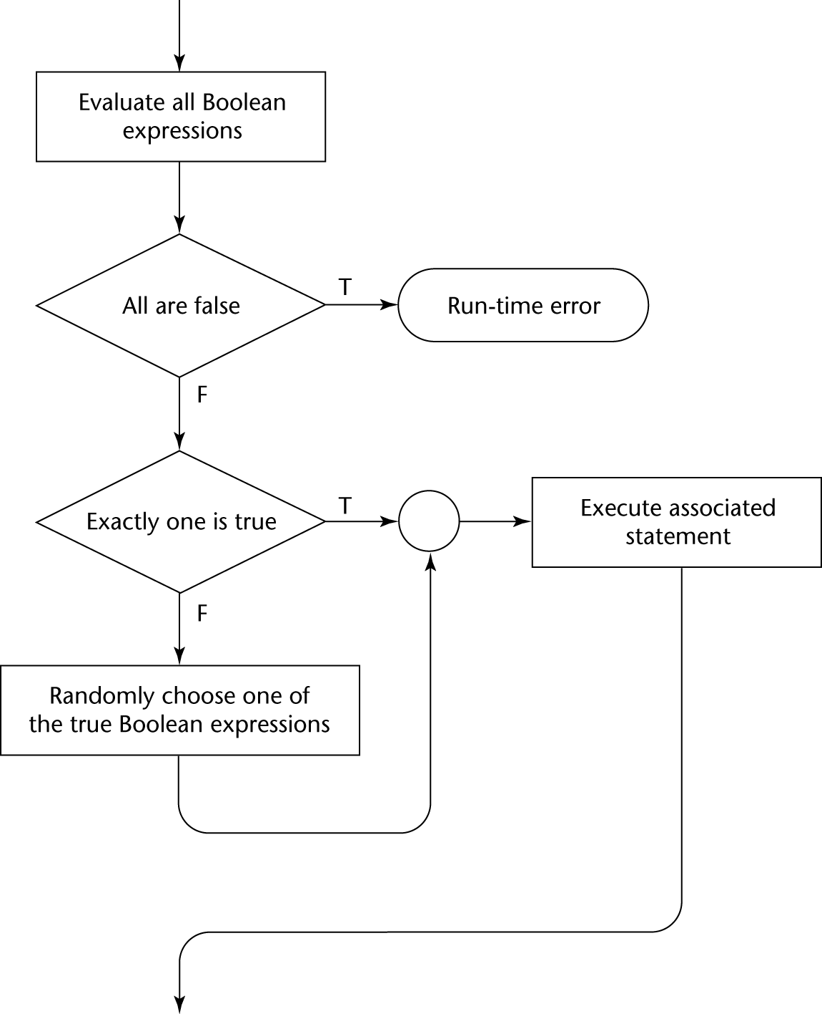
Selection Guarded Command: Illustrated

Slide 362
Selection Guarded Command Example
if i = 0 -> sum := sum + i
[] i > j -> sum := sum + j
[] j > i -> sum := sum + i
fi
if x >= y -> max := x
[] y >= x -> max := y
fi
How would you do with ordinary coding?

Slide 363
Loop Guarded Command
Form
do <Boolean> -> <statement>
[] <Boolean> -> <statement>
...
[] <Boolean> -> <statement>
od
Semantics: for each iteration
Evaluate all Boolean expressions
If more than one are true, choose one non-deterministically; then start loop again
If none are true, exit loop

Slide 364
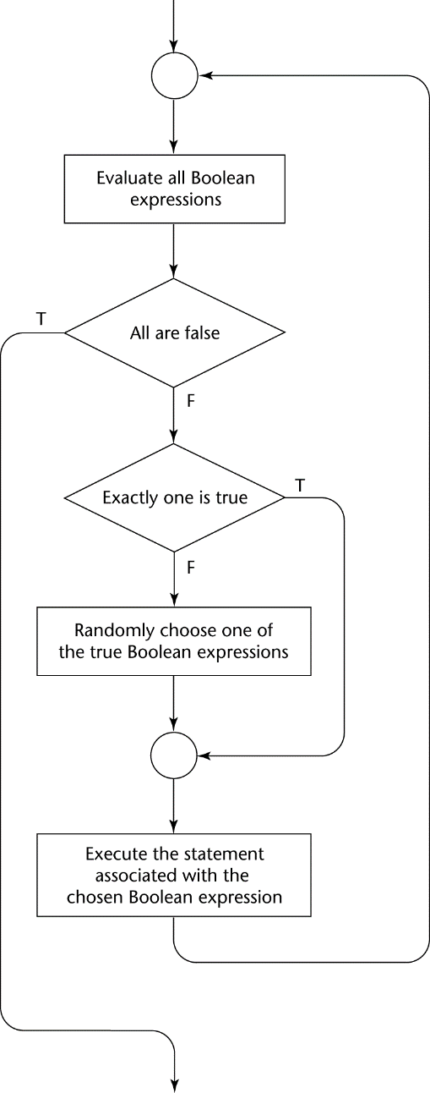
Loop Guarded Command: Illustrated

Slide 365
Loop Guarded Command Example
do q1 > q2 -> temp := q1; q1 := q2; q2 := temp;
[] q2 > q3 -> temp := q2; q2 := q3; q3 := temp;
[] q3 > q4 -> temp := q3; q3 := q4; q4 := temp;
od
How would you do with ordinary coding?

Slide 366
Guarded Commands: Rationale
Connection between control statements and program verification is intimate
Verification is impossible with goto statements
Verification is possible with only selection and logical pretest loops
Verification is relatively simple with only guarded commands

Slide 367
Conclusion
Variety of statement-level structures
Choice of control statements beyond selection and logical pretest loops is a trade-off between language size and writability
Functional and logic programming languages are quite different control structures

Slide 368
Chapter 8
Subprograms

Slide 369
Chapter 9 Topics
Introduction
Fundamentals of Subprograms
Design Issues for Subprograms
Local Referencing Environments
Parameter-Passing Methods
Parameters That Are Subprogram Names
Overloaded Subprograms
Generic Subprograms
Design Issues for Functions
User-Defined Overloaded Operators
Coroutines

Slide 370
Introduction
Two fundamental abstraction facilities
Process abstraction
Emphasized from early days
Data abstraction
Emphasized in the1980s

Slide 371
Fundamentals of Subprograms
Each subprogram has a single entry point
The calling program is suspended during execution of the called subprogram
Control always returns to the caller when the called subprogram’s execution terminates

Slide 372
Basic Definitions
A subprogram definition describes the interface to and the actions of the subprogram abstraction
A subprogram call is an explicit request that the subprogram be executed
A subprogram header is the first part of the definition, including the name, the kind of subprogram, and the formal parameters
The parameter profile (aka signature) of a subprogram is the number, order, and types of its parameters
The protocol is a subprogram’s parameter profile and, if it is a function, its return type

Slide 373
Basic Definitions (continued)
Function declarations in C and C++ are often called prototypes
A subprogram declaration provides the protocol, but not the body, of the subprogram
A formal parameter is a dummy variable listed in the subprogram header and used in the subprogram
An actual parameter represents a value or address used in the subprogram call statement

Slide 374
Actual/Formal Parameter Correspondence
Positional
The binding of actual parameters to formal parameters is by position: the first actual parameter is bound to the first formal parameter and so forth
Safe and effective
Keyword
The name of the formal parameter to which an actual parameter is to be bound is specified with the actual parameter
Parameters can appear in any order

Slide 375
Formal Parameter Default Values
In certain languages (e.g., C++, Ada), formal parameters can have default values (if not actual parameter is passed)
In C++, default parameters must appear last because parameters are positionally associated
C# methods can accept a variable number of parameters as long as they are of the same type

Slide 376
Procedures and Functions
There are two categories of subprograms
Procedures are collection of statements that define parameterized computations
Functions structurally resemble procedures but are semantically modeled on mathematical functions
They are expected to produce no side effects
In practice, program functions have side effects

Slide 377
Design Issues for Subprograms
What parameter passing methods are provided?
Are parameter types checked?
Are local variables static or dynamic?
Can subprogram definitions appear in other subprogram definitions?
Can subprograms be overloaded?
Can subprogram be generic?

Slide 378
Local Referencing Environments
Local variables can be stack-dynamic (bound to storage)
Advantages
Support for recursion
Storage for locals is shared among some subprograms
Disadvantages
Allocation/de-allocation, initialization time
Indirect addressing
Subprograms cannot be history sensitive
Local variables can be static
More efficient (no indirection)
No run-time overhead
Cannot support recursion

Slide 379
Parameter Passing Methods
Ways in which parameters are transmitted to and/or from called subprograms
Pass-by-value
Pass-by-result
Pass-by-value-result
Pass-by-reference
Pass-by-name

Slide 380
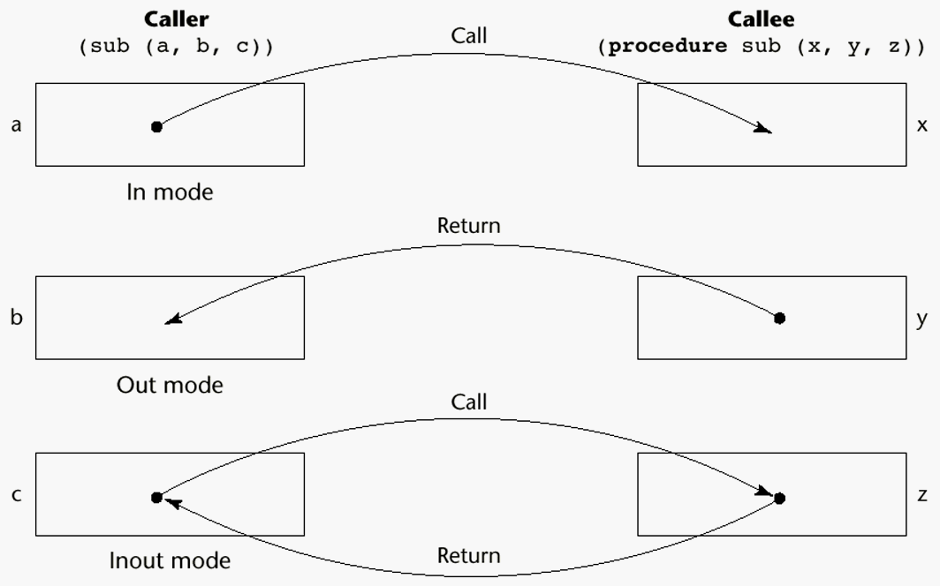
Models of Parameter Passing

Slide 381
Pass-by-Value (In Mode)
The value of the actual parameter is used to initialize the corresponding formal parameter
Normally implemented by copying
Can be implemented by transmitting an access path but not recommended (enforcing write protection is not easy)
When copies are used, additional storage is required
Storage and copy operations can be costly (large parameters)

Slide 382
Pass-by-Result (Out Mode)
When a parameter is passed by result, no value is transmitted to the subprogram; the corresponding formal parameter acts as a local variable; its value is transmitted to caller’s actual parameter when control is returned to the caller
Require extra storage location and copy operation
Potential problem: sub(p1, p1); whichever formal parameter is copied back will represent the current value of p1

Slide 383
Pass-by-Value-Result (inout Mode)
A combination of pass-by-value and pass-by-result
Sometimes called pass-by-copy
Formal parameters have local storage
Disadvantages:
Those of pass-by-result
Those of pass-by-value

Slide 384
Pass-by-Reference (Inout Mode)
Pass an access path
Also called pass-by-sharing
Passing process is efficient (no copying and no duplicated storage)
Disadvantages
Slower accesses (compared to pass-by-value) to formal parameters
Potentials for un-wanted side effects
Un-wanted aliases (access broadened)

Slide 385
Pass-by-Name (Inout Mode)
By textual substitution
Formals are bound to an access method at the time of the call, but actual binding to a value or address takes place at the time of a reference or assignment
Allows flexibility in late binding

Slide 386
Exercise
Consider the following program written in C syntax:
void fun (int first, int second)
{
first += first;
second += second;
}
void main()
{
int list[2] = {1, 3};
fun(list[0], list[1]);
}
For each of the following parameter-passing methods, what are the values
of the list array after execution?
a. Passed by value
b. Passed by reference
c. Passed by value-result

Slide 387
Implementing Parameter-Passing Methods
In most language parameter communication takes place thru the run-time stack
Pass-by-reference are the simplest to implement; only an address is placed in the stack
A subtle but fatal error can occur with pass-by-reference and pass-by-value-result: a formal parameter corresponding to a constant can mistakenly be changed

Slide 388
Parameter Passing Methods of Major Languages
Fortran
Always used the inout semantics model
Before Fortran 77: pass-by-reference
Fortran 77 and later: scalar variables are often passed by value-result
C
Pass-by-value
Pass-by-reference is achieved by using pointers as parameters
C++
A special pointer type called reference type for pass-by-reference
Java
All parameters are passed are passed by value
Object parameters are passed by reference

Slide 389
Parameter Passing Methods of Major Languages (continued)
Ada
Three semantics modes of parameter transmission: in, out, in out; in is the default mode
Formal parameters declared out can be assigned but not referenced; those declared in can be referenced but not assigned; in out parameters can be referenced and assigned
C#
Default method: pass-by-value
Pass-by-reference is specified by preceding both a formal parameter and its actual parameter with ref
PHP: very similar to C#
Perl: all actual parameters are implicitly placed in a predefined array named @_

Slide 390
Type Checking Parameters
Considered very important for reliability
FORTRAN 77 and original C: none
Pascal, FORTRAN 90, Java, and Ada: it is always required
ANSI C and C++: choice is made by the user
Prototypes
Relatively new languages Perl, JavaScript, and PHP do not require type checking

Slide 391
Multidimensional Arrays as Parameters
If a multidimensional array is passed to a subprogram and the subprogram is separately compiled, the compiler needs to know the declared size of that array to build the storage mapping function

Slide 392
Multidimensional Arrays as Parameters: C and C++
Programmer is required to include the declared sizes of all but the first subscript in the actual parameter
Disallows writing flexible subprograms
Solution: pass a pointer to the array and the sizes of the dimensions as other parameters; the user must include the storage mapping function in terms of the size parameters

Slide 393
Multidimensional Arrays as Parameters: Pascal and Ada
Pascal
Not a problem; declared size is part of the array’s type
Ada
Constrained arrays - like Pascal
Unconstrained arrays - declared size is part of the object declaration

Slide 394
Multidimensional Arrays as Parameters: Fortran
Formal parameter that are arrays have a declaration after the header
For single-dimension arrays, the subscript is irrelevant
For multi-dimensional arrays, the subscripts allow the storage-mapping function

Slide 395
Multidimensional Arrays as Parameters: Java and C#
Similar to Ada
Arrays are objects; they are all single-dimensioned, but the elements can be arrays
Each array inherits a named constant (length in Java, Length in C#) that is set to the length of the array when the array object is created

Slide 396
Design Considerations for Parameter Passing
Two important considerations
Efficiency
One-way or two-way data transfer
But the above considerations are in conflict
Good programming suggest limited access to variables, which means one-way whenever possible
But pass-by-reference is more efficient to pass structures of significant size

Slide 397
Parameters that are Subprogram Names
It is sometimes convenient to pass subprogram names as parameters
Issues:
Are parameter types checked?
What is the correct referencing environment for a subprogram that was sent as a parameter?

Slide 398
Parameters that are Subprogram Names: Parameter Type Checking
C and C++: functions cannot be passed as parameters but pointers to functions can be passed; parameters can be type checked
FORTRAN 95 type checks
Later versions of Pascal and
Ada does not allow subprogram parameters; a similar alternative is provided via Ada’s generic facility

Slide 399
Parameters that are Subprogram Names: Referencing Environment
Shallow binding: The environment of the call statement that enacts the passed subprogram
Deep binding: The environment of the definition of the passed subprogram
Ad hoc binding: The environment of the call statement that passed the subprogram as actual parameter.

Slide 400
Parameters that are Subprogram Names
function sub1(){ Shallow binding, x = 4
var x;
function sub2(){ Deep binding, x = 1
alert(x);
}; Ad hoc binding, x = 3
function sub3(){
var x=3;
sub4(sub2);
};
function sub4(subx){
var x=4;
subx();
};
x=1;
sub3();
};

Slide 401
Overloaded Subprograms
An overloaded subprogram is one that has the same name as another subprogram in the same referencing environment
Every version of an overloaded subprogram has a unique protocol
C++, Java, C#, and Ada include predefined overloaded subprograms
In Ada, the return type of an overloaded function can be used to disambiguate calls (thus two overloaded functions can have the same parameters)
Ada, Java, C++, and C# allow users to write multiple versions of subprograms with the same name

Slide 402
Generic Subprograms
A generic or polymorphic subprogram takes parameters of different types on different activations
Overloaded subprograms provide ad hoc polymorphism
A subprogram that takes a generic parameter that is used in a type expression that describes the type of the parameters of the subprogram provides parametric polymorphism

Slide 403
Examples of parametric polymorphism: C++
template <class Type>
Type max(Type first, Type second) {
return first > second ? first : second;
}
The above template can be instantiated for any type for which operator > is defined
int max (int first, int second) {
return first > second? first : second;
}

Slide 404
Design Issues for Functions
Are side effects allowed?
Parameters should always be in-mode to reduce side effect (like Ada)
What types of return values are allowed?
Most imperative languages restrict the return types
C allows any type except arrays and functions
C++ is like C but also allows user-defined types
Ada allows any type
Java and C# do not have functions but methods can have any type

Slide 405
User-Defined Overloaded Operators
Operators can be overloaded in Ada and C++
An Ada example
Function “*”(A,B: in Vec_Type): return Integer is
Sum: Integer := 0;
begin
for Index in A’range loop
Sum := Sum + A(Index) * B(Index)
end loop
return sum;
end “*”;
…
c = a * b; -- a, b, and c are of type Vec_Type

Slide 406
Coroutines
A coroutine is a subprogram that has multiple entries and controls them itself
Also called symmetric control: caller and called coroutines are on a more equal basis
A coroutine call is named a resume
The first resume of a coroutine is to its beginning, but subsequent calls enter at the point just after the last executed statement in the coroutine
Coroutines repeatedly resume each other, possibly forever
Coroutines provide quasi-concurrent execution of program units (the coroutines); their execution is interleaved, but not overlapped

Slide 407
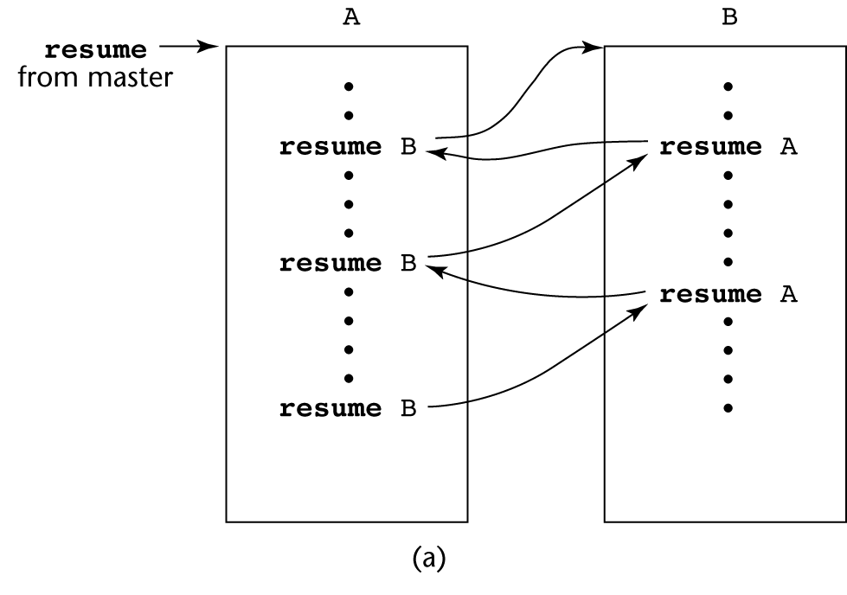
Coroutines Illustrated: Possible Execution Controls

Slide 408
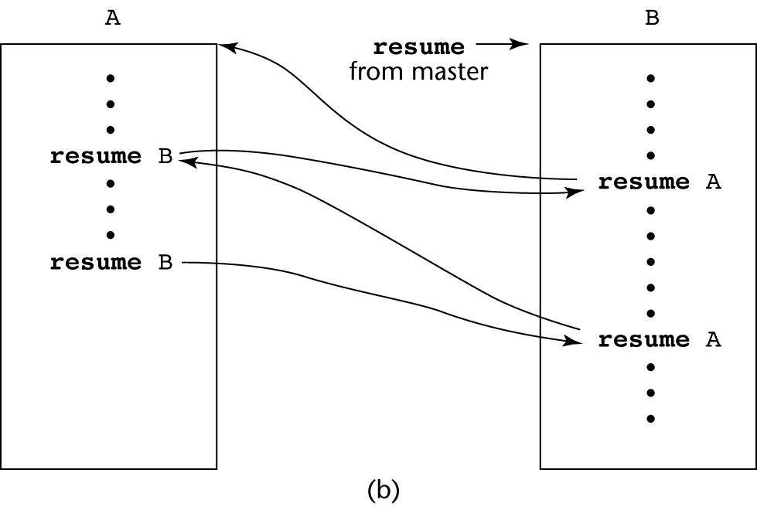
Coroutines Illustrated: Possible Execution Controls

Slide 409
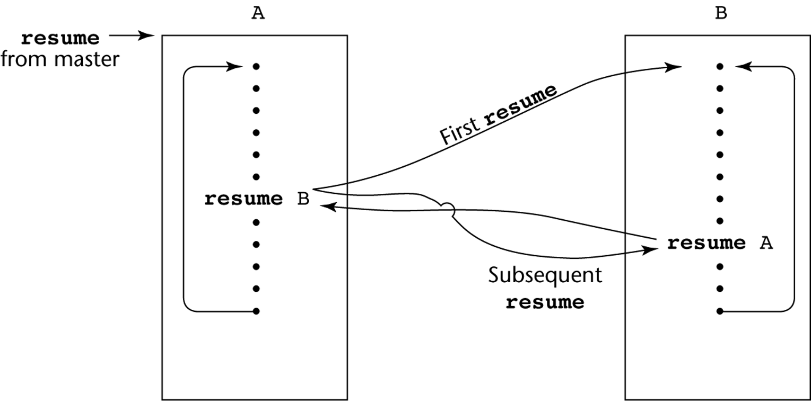
Coroutines Illustrated: Possible Execution Controls with Loops

Slide 410
Summary
A subprogram definition describes the actions represented by the subprogram
Subprograms can be either functions or procedures
Local variables in subprograms can be stack-dynamic or static
Three models of parameter passing: in mode, out mode, and inout mode
Some languages allow operator overloading
Subprograms can be generic
A coroutine is a special subprogram with multiple entries

Slide 411
Chapter 9
Implementing Subprograms

Slide 412
Chapter 10 Topics
The General Semantics of Calls and Returns
Implementing “Simple” Subprograms
Implementing Subprograms with Stack-Dynamic Local Variables
Nested Subprograms
Blocks
Implementing Dynamic Scoping

Slide 413
The General Semantics of Calls and Returns
The subprogram call and return operations of a language are together called its subprogram linkage
A subprogram call has numerous actions associated with it
Parameter passing methods
Static local variables
Execution status of calling program
Transfer of control
Subprogram nesting

Slide 414
Implementing “Simple” Subprograms: Call Semantics
Save the execution status of the caller
Carry out the parameter-passing process
Pass the return address to the callee
Transfer control to the callee

Slide 415
Implementing “Simple” Subprograms: Return Semantics
If pass-by-value-result parameters are used, move the current values of those parameters to their corresponding actual parameters
If it is a function, move the functional value to a place the caller can get it
Restore the execution status of the caller
Transfer control back to the caller

Slide 416
Implementing “Simple” Subprograms: Parts
Two separate parts: the actual code and the noncode part (local variables and data that can change)
The format, or layout, of the noncode part of an executing subprogram is called an activation record
An activation record instance is a concrete example of an activation record (the collection of data for a particular subprogram activation)

Slide 417
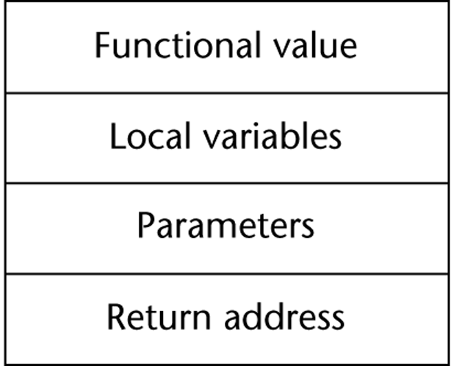
An Activation Record for “Simple” Subprograms

Slide 418
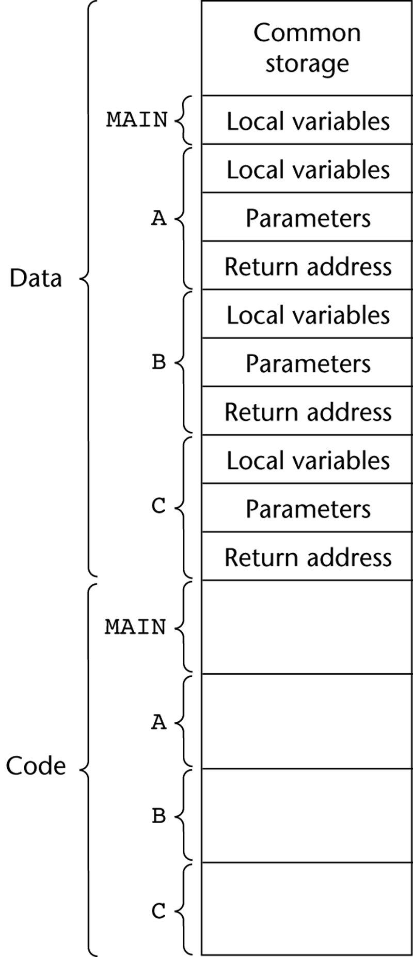
Code and Activation Records of a Program with “Simple” Subprograms

Slide 419
Implementing Subprograms with Stack-Dynamic Local Variables
More complex activation record
The compiler must generate code to cause implicit allocation and de-allocation of local variables
Recursion must be supported (adds the possibility of multiple simultaneous activations of a subprogram)

Slide 420
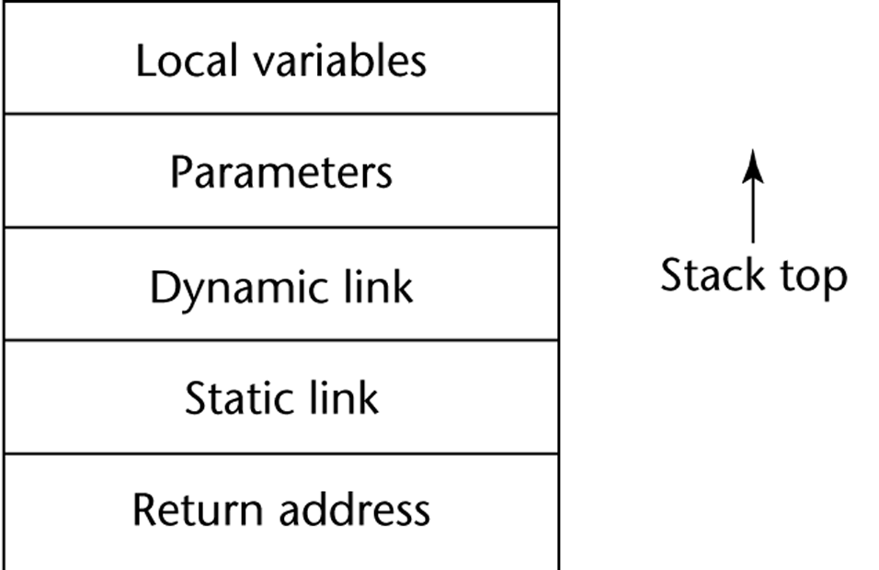
Typical Activation Record for a Language with Stack-Dynamic Local Variables

Slide 421
Implementing Subprograms with Stack-Dynamic Local Variables: Activation Record
The activation record format is static, but its size may be dynamic
The dynamic link points to the top of an instance of the activation record of the caller
An activation record instance is dynamically created when a subprogram is called
Run-time stack

Slide 422
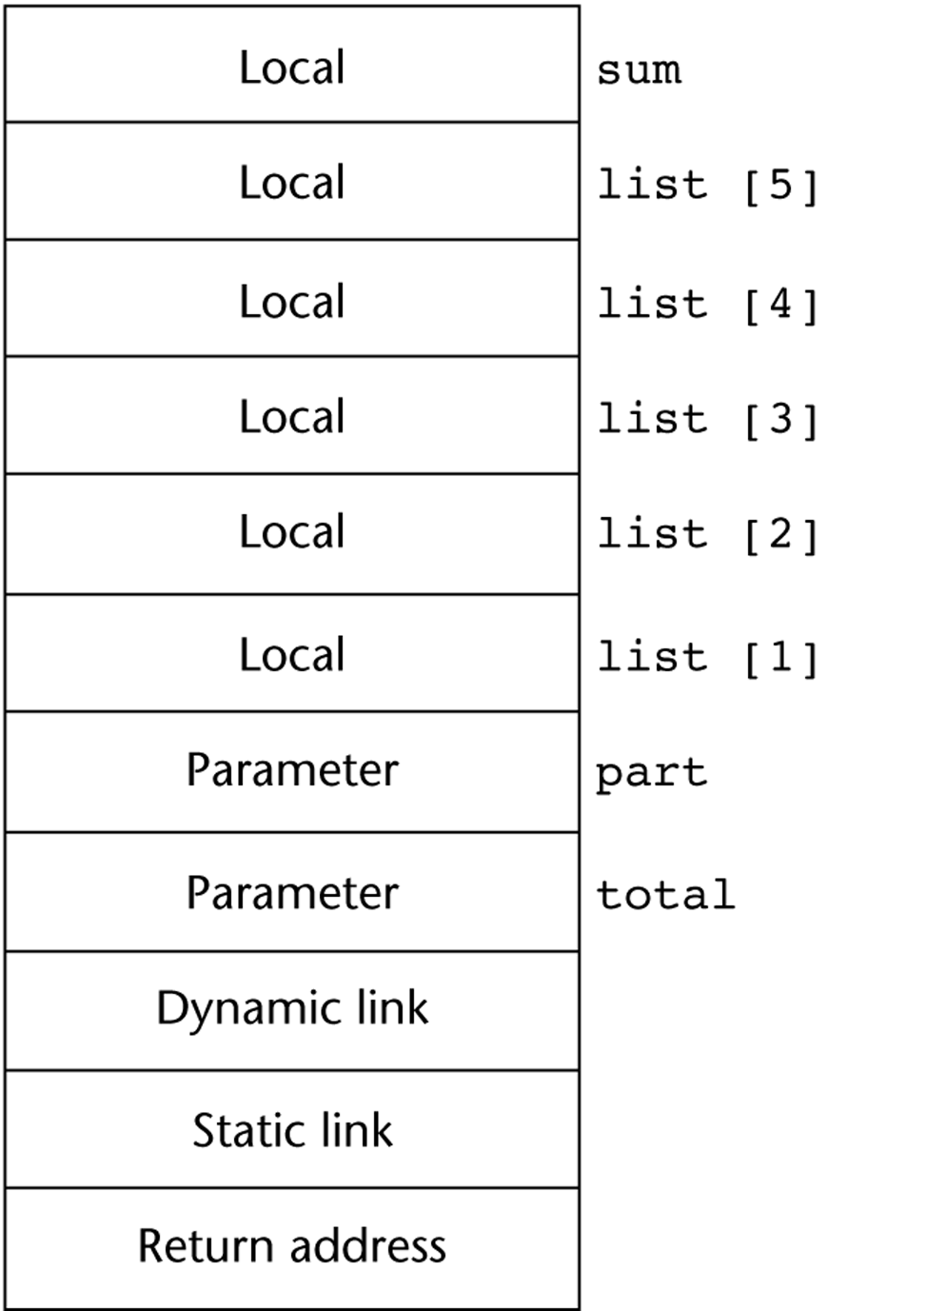
An Example: C Function
void sub(float total, int part)
{
int list[6];
float sum;
…
}
[4]
[3]
[2]
[1]
[0]

Slide 423
An Example Without Recursion
void A(int x) {
int y;
...
C(y);
...
}
void B(float r) {
int s, t;
...
A(s);
...
}
void C(int q) {
...
}
void main() {
float p;
...
B(p);
...
}
main calls B
B calls A
A calls C

Slide 424
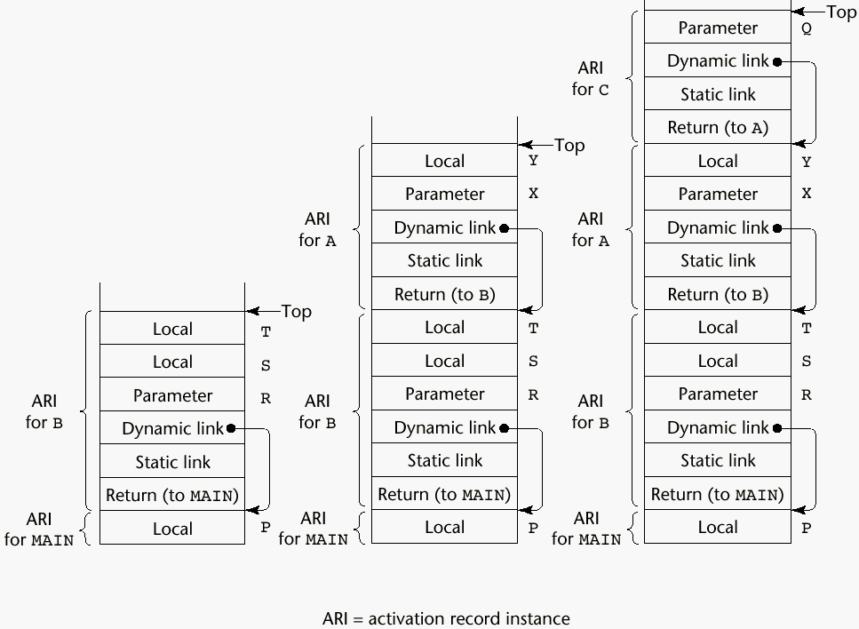
An Example Without Recursion

Slide 425
Dynamic Chain and Local Offset
The collection of dynamic links in the stack at a given time is called the dynamic chain, or call chain
Local variables can be accessed by their offset from the beginning of the activation record. This offset is called the local_offset
The local_offset of a local variable can be determined by the compiler at compile time

Slide 426
An Example With Recursion
The activation record used in the previous example supports recursion, e.g.
int factorial (int n) {
<-----------------------------1
if (n <= 1) return 1;
else return (n * factorial(n - 1));
<-----------------------------2
}
void main() {
int value;
value = factorial(3);
<-----------------------------3
}

Slide 427
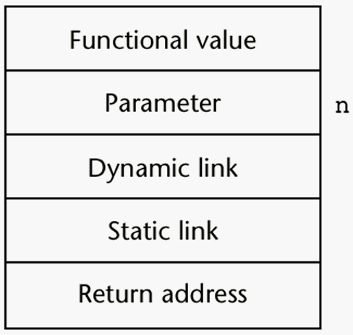
Activation Record for factorial

Slide 428
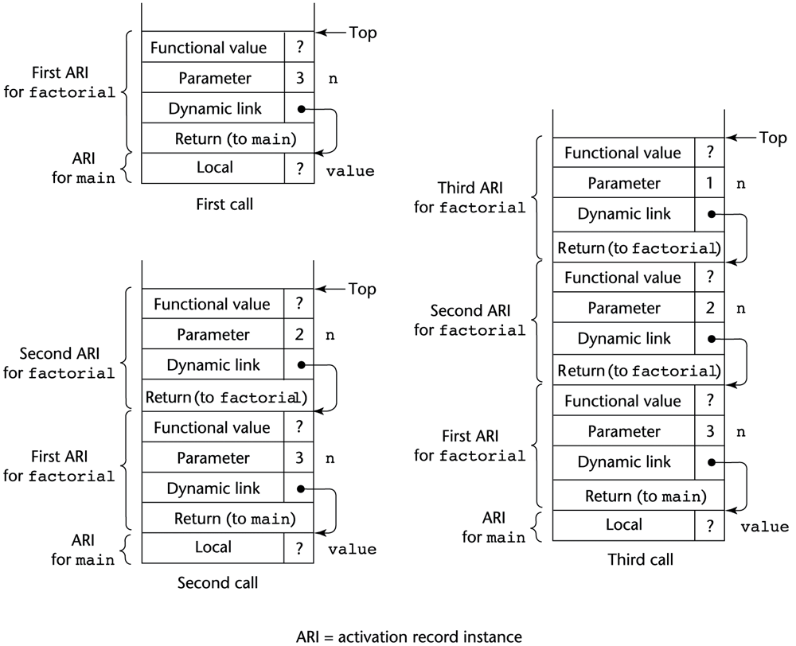
Example with recursion (Part I)

Slide 429
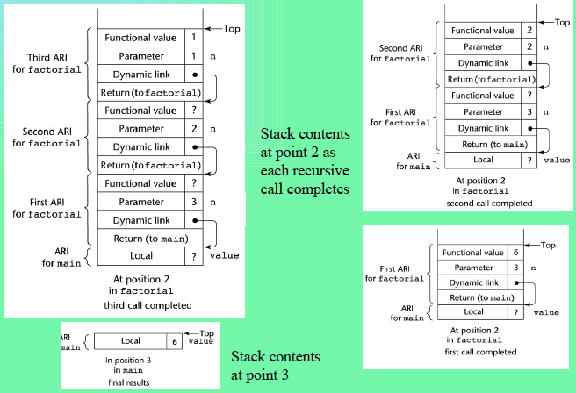
Example with recursion (Part II)

Slide 430
Nested Subprograms
Some non-C-based static-scoped languages (e.g., Fortran 95, Ada, JavaScript) use stack-dynamic local variables and allow subprograms to be nested
All variables that can be non-locally accessed reside in some activation record instance in the stack
The process of locating a non-local reference:
Find the correct activation record instance
Determine the correct offset within that activation record instance

Slide 431
Locating a Non-local Reference
Finding the offset is easy
Finding the correct activation record instance
Static semantic rules guarantee that all non-local variables that can be referenced have been allocated in some activation record instance that is on the stack when the reference is made

Slide 432
Static Scoping
A static chain is a chain of static links that connects certain activation record instances
The static link in an activation record instance for subprogram A points to one of the activation record instances of A's static parent
The static chain from an activation record instance connects it to all of its static ancestors

Slide 433
Example Pascal Program
program MAIN_2;
var X : integer;
procedure BIGSUB;
var A, B, C : integer;
procedure SUB1;
var A, D : integer;
begin { SUB1 }
A := B + C; <-----------------------1
end; { SUB1 }
procedure SUB2(X : integer);
var B, E : integer;
procedure SUB3;
var C, E : integer;
begin { SUB3 }
SUB1;
E := B + A: <--------------------2
end; { SUB3 }
begin { SUB2 }
SUB3;
A := D + E; <-----------------------3
end; { SUB2 }
begin { BIGSUB }
SUB2(7);
end; { BIGSUB }
begin
BIGSUB;
end; { MAIN_2 }

Slide 434
Example Pascal Program (continued)
Call sequence for MAIN_2
MAIN_2 calls BIGSUB
BIGSUB calls SUB2
SUB2 calls SUB3
SUB3 calls SUB1

Slide 435
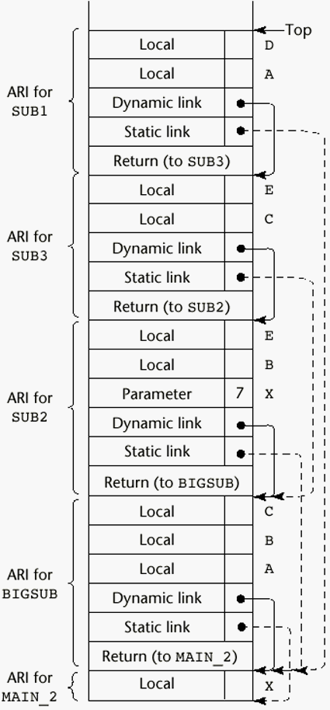
Stack Contents at Position 1

Slide 436
Displays
An alternative to static chains
Static links are stored in a single array called a display
The contents of the display at any given time is a list of addresses of the accessible activation record instances

Slide 437
Blocks
Blocks are user-specified local scopes for variables
An example in C
{int temp;
temp = list [upper];
list [upper] = list [lower];
list [lower] = temp
}
The lifetime of temp in the above example begins when control enters the block
An advantage of using a local variable like temp is that it cannot interfere with any other variable with the same name

Slide 438
Implementing Blocks
Two Methods:
Treat blocks as parameter-less subprograms that are always called from the same location
Every block has an activation record; an instance is created every time the block is executed
2. Since the maximum storage required for a block can be statically determined, this amount of space can be allocated after the local variables in the activation record

Slide 439
Implementing Dynamic Scoping
Deep Access: non-local references are found by searching the activation record instances on the dynamic chain
Shallow Access: put locals in a central place
One stack for each variable name
Central table with an entry for each variable name

Slide 440
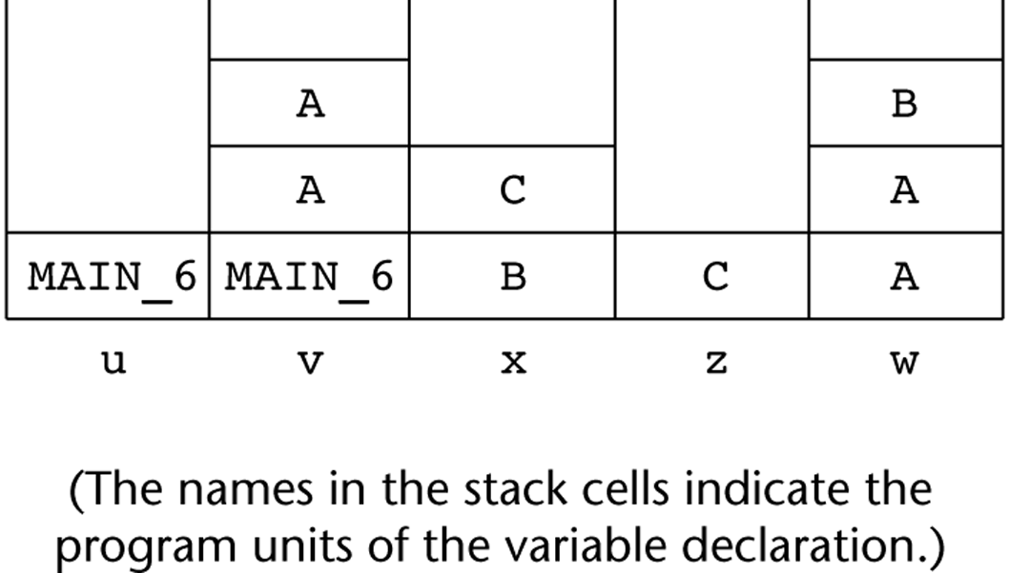
Using Shallow Access to Implement Dynamic Scoping

Slide 441
Summary
Subprogram linkage semantics requires many action by the implementation
Simple subprograms have relatively basic actions
Stack-dynamic languages are more complex
Subprograms with stack-dynamic local variables and nested subprograms have two components
actual code
activation record

Slide 442
Summary (continued)
Activation record instances contain formal parameters and local variables among other things
Static chains are the primary method of implementing accesses to non-local variables in static-scoped languages with nested subprograms
Access to non-local variables in dynamic-scoped languages can be implemented by use of the dynamic chain or thru some central variable table method

